Slide 1
Can We Trust the Bible?

Slide 2
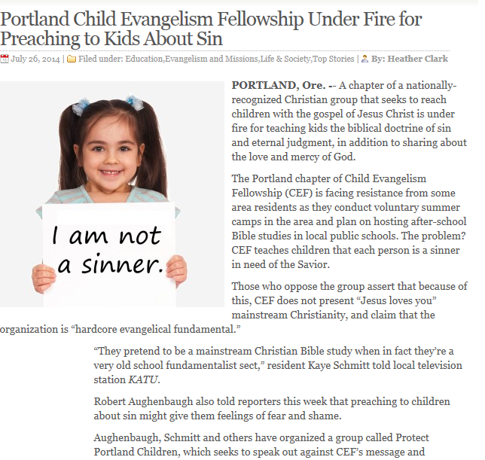
Notes:
Christian News Network, Sat., July 26 Rom. 3:23

Slide 3
The Biblical Basis to Believe the Bible
Can we trust the Bible?
YES.
Why?

Slide 4
The Biblical Basis to Believe the Bible
Because the Bible is authoritative
Huh?
“The authority of Scripture means that all the words in Scripture are God’s words in such a way that to disbelieve or disobey any word of Scripture is to disbelieve or disobey God.” -Wayne Grudem

Slide 5
The Biblical Basis to Believe the Bible
What is the basis for the authority of the Bible?
All the words of Scripture are God’s words
So, disbelieving or disobeying the words of Scripture is to disbelieve or disobey God
Scripture is truthful
Scripture is inerrant

Slide 6
All the words of the Bible are God’s words.
The Bible makes this claim regarding the O.T.:
All Scripture is breathed out by God and profitable for teaching, for reproof, for correction, and for training in righteousness, 2 Tim. 3:16
-referring to OT canon
-”scripture” graphe (GR)used 51 times in NT

Slide 7
All the words of the Bible are God’s words.
“breathed out by God” theopneustos (GR)
The sacred writings of v. 15 (Scripture) have been breathed out, spoken, as the words of God.
”For no prophecy was ever produced by the will of man, but men spoke from God as they were carried along by the Holy Spirit.” 2 Pet. 1:21

Slide 8
All the words of the Bible are God’s words
God used prophets:
They had to speak God’s word or be revealed as a false prophet
”Balaam said to Balak, “Behold, I have come to you! Have I now any power of my own to speak anything? The word that God puts in my mouth, that must I speak.” Num. 22:38

Slide 9
All the words of the Bible are God’s words
“Then the Lord put out his hand and touched my mouth. And the Lord said to me, ‘Behold, I have put my words in your mouth.’” Jer. 1:9
(See also 1 Kings 14:18; Jer. 37:2; Hag. 1:12; Luke 1:70; Acts 3:18)

Slide 10
All the words of the Bible are God’s words
The Bible makes this claim in the N.T.
“And count the patience of our Lord as salvation, just as our beloved brother Paul also wrote to you according to the wisdom given him, as he does in all his letters when he speaks in them of these matters. There are some things in them that are hard to understand, which the ignorant and unstable twist to their own destruction, as they do the other Scriptures.” 2 Pet. 3:15-16

Slide 11
All the words of the Bible are God’s words
“For the Scripture says, “You shall not muzzle an ox when it treads out the grain,” and, “The laborer deserves his wages.” 1 Tim. 5:18
(Paul quoting Deut. 25:4 and Luke 10:7)

Slide 12
All the words of the Bible are God’s words
“If anyone thinks that he is a prophet, or spiritual, he should acknowledge that the things I am writing to you are a command of the Lord.”
1 Cor. 10:37
Notes:
Paul attesting that his words are given to him by God.

Slide 13
Disbelieving Scripture is Disbelieving God
Jesus warned against this-
“And he said to them, “O foolish ones, and slow of heart to believe all that the prophets have spoken!” Luke 24:25
“But this is the one to whom I will look: he who is humble and contrite in spirit and trembles at my word.” Isa. 66:2b

Slide 14
Scripture is Truthful
God is incapable of lying-
“…in hope of eternal life, which God, who never lies, promised before the ages began…” Titus 1:2 (Cf. Heb. 6:18)
Every word of God proves true;
Prov. 30:5a

Slide 15
Scripture is Truthful
God’s word is the ultimate standard of truth for humanity-
“Sanctify them in the truth; your word is truth.”
^{John 17:17}

Slide 16
Scripture is Inerrant
Inerrancy means that Scripture in the original manuscripts does not affirm anything contrary to fact. -Grudem
The Bible always tells the truth; it always tells the truth about everything it talks about.

Slide 17
Scripture is Inerrant
Scripture is pure-
“The words of the Lord are pure words, like silver refined… purified seven times.” Ps. 12:6
Scripture is perfect-
“I have seen a limit to all perfection, but your commandment is exceedingly broad.” Ps. 199:96

Slide 18
Scripture is Inerrant
God warns those that would change His word-
“You shall not add to the word that I command you, nor take from it, that you may keep the commandments of the Lord your God that I command you.”
-Deut. 4:2

Slide 19
Scripture is Inerrant
”I warn everyone who hears the words of the prophecy of this book: if anyone adds to them, God will add to him the plagues described in this book, and if anyone takes away from the words of the book of this prophecy, God will take away his share in the tree of life and in the holy city, which are described in this book.”
–Rev. 22:18-19

Slide 20
The Practical Basis to Believe the Bible
That would be all well and good IF I believe what you're claiming and IF I believe the Bible, but…
I don’t.
How am I to trust something that claims to be 2000 yrs. + old?
How do I know the whole thing is not made up?

Slide 21
The Practical Basis to Believe the Bible
Number of handwritten Greek manuscripts of the New Testament:
5,700
Number of N.T. manuscripts in other languages (Latin, Arabic, Coptic, etc.)
9,000 Geisler/Turek

Slide 22
The Practical Basis to Believe the Bible
Compare to copies of Homer’s Iliad,
643 manuscripts
Geisler/Turek
Notes:
When is the last time someone attacked the Iliad as non-historical?

Slide 23
The Practical Basis to Believe the Bible
The earliest un-disputed manuscript:
the John Rylands manuscript
- segment of John 18:31-33 and
37-38
- dated between 117-138 AD
- John wrote his Gospel 85-95 AD
- shows this segment was copied and distributed widely by the 2nd century Geisler/Turek

Slide 24
The Practical Basis to Believe the Bible
Complete N.T. book manuscripts survive from 200 AD
The complete N.T., including the Gospels, survives from 250 AD
Codex Vaticanus, a complete N.T. and Greek O.T. survives from 325 AD
Geisler/Turek

Slide 25
The Practical Basis to Believe the Bible
Get this:
The early church fathers (Justin Martyr, Irenaeus, Clement of Alexandria, Origen, Tertullian) quoted the N.T. over 36,289 times.
That is so prolific that, using their words, all but eleven verses of the N.T. can be reconstructed from their quotes. Geisler/Turek

Slide 26
The Practical Basis to Believe the Bible
The Mahabharata (Hindu)- copied 90% accurate
Homer’s Iliad –
copied 95% accurate
The New Testament-
copied 99.5% accurate
(nothing in the 0.5% that is questioned affects a single point of Christian doctrine)
Geisler/Turek

Slide 27
The Practical Basis to Believe the Bible
All the N.T. books were written before 100 AD- about 70 years after the death of Christ.
Between 95-110 AD, Clement, Ignatius and Polycarp (early church fathers) quoted passages from 25 of the 27 N.T. books.
Geisler/Turek

Slide 28
The Devine Basis to Rely on the Bible
The Bible is God’s revealed special revelation to his disciples
There are 929 chapters in the Old Testament
There are 260 chapters in the New Testament
There is a total of 1,189 chapters in the Bible

Slide 29
The Devine Basis to Rely on the Bible
The longest chapter, 150 verses, is Psalm 119
The locus of the entirety of Psalm 119-
Celebrating the gift of God’s Torah, as the perfect guide for life.

Slide 30
The Devine Basis to Rely on the Bible
“Blessed is the man who walks not in the counsel of the wicked, nor stands in the way of sinners, nor sits in the seat of scoffers; but his delight is in the law of the LORD, and on his law he meditates day and night. He is like a tree planted by streams of water that yields its fruit in its season, and its leaf does not wither. In all that he does, he prospers.” Ps. 1:1-3

Slide 31
Don’t’ be afraid to share the Bible!
Notes:
Read Ps. 119:33-40

Slide 32
Check It Out Yourself-
I Don’t Have Enough Faith to Be an Atheist,
N. Geisler & F. Turek, Crossway, 2004
A General Introduction to the Bible,
N. Geisler & W. Nix, Moody Press, 1986
The New Testament Documents: Are They Reliable?
F.F. Bruce, InterVarsity Press, 1981
The Journey from Texts to Translations: The Origin and Development of the Bible
Paul Wegner, Baker Academic, 2004

Slide 33
The Biblical Basis for Apologetics

