Slide 1
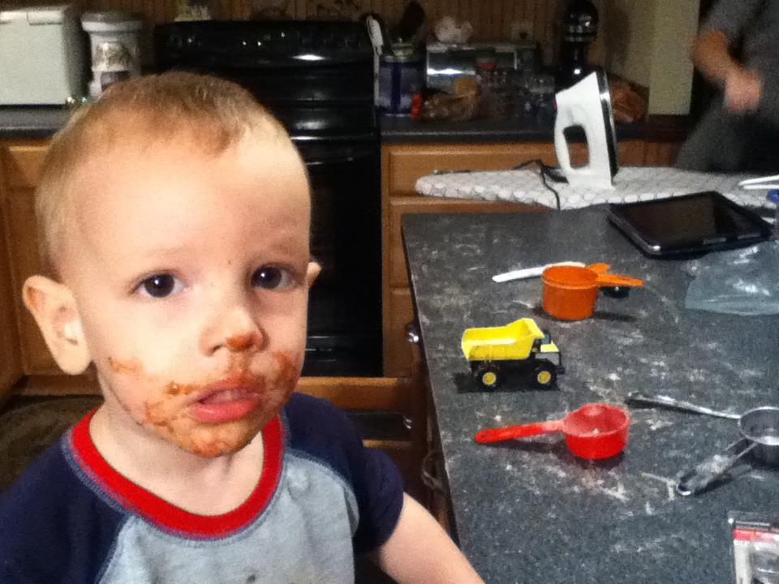
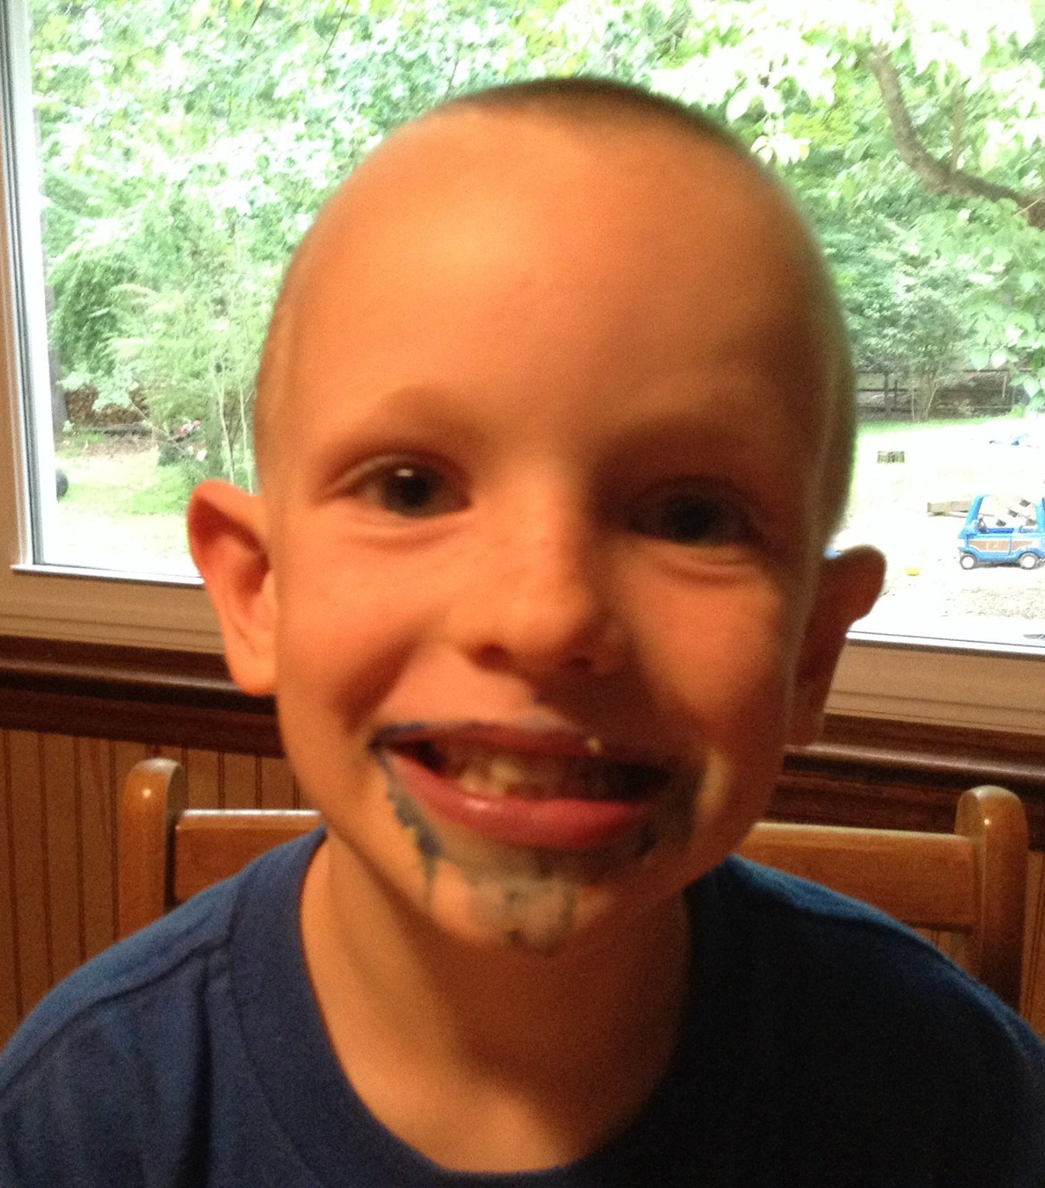

Slide 2
Why Should We Listen to Preaching?
And What Should We Do With it?

Slide 3
Why Should We Listen to Preaching?
Why Do We Preach?
What Do We Preach?
What Does God Do With It?
What Do We Do With It?

Slide 4
Why / What Do We Preach?
1 Cor. 1:21-24
Rom. 10:1-15

Slide 5
Why / What Do We Preach?
Why? God ordained preaching as a means of proclaiming His Good News of salvation in Jesus Christ

Slide 6
Why / What Do We Preach?
What? The Good News of salvation in Jesus Christ

Slide 7
Why / What Do We Preach?
2 Tim. 3:10-4:5
  Why? To equip
    How? Teaching, reproving, correcting, training

Slide 8
Why / What Do We Preach?
2 Tim. 3:10-4:5
  What? The Word, sound doctrine

Slide 9
What Does God Do With It?
He wrote it!
  2 Pet. 1:21 – “but men moved by the Holy Spirit spoke from God.” (See Acts 1:16; 4:25)

Slide 10
What Does God Do With It?
He uses it to save us
  1 Pet. 1:23 – we are born again through the Word

Slide 11
What Does God Do With It?
He helps us understand it
  1 Cor. 2:11-13
  Illumination

Slide 12
What Does God Do With It?
He causes the growth
  1 Cor. 3:1-9

Slide 13
So, What Do We Do With It?
We Weigh It
We Obey It

Slide 14
So, What Do We Do With It?
2 Tim. 3:16-17

Slide 15
So, What Do We Do With It?
2 Tim. 3:16-17 -- teaching, reproving, correcting, training
  What is the assumption?

Slide 16
So, What Do We Do With It?
2 Tim. 3:16-17 -- teaching, reproving, correcting, training
  Humbly submit to the truth
  Accept instruction/training

Slide 17
So, What Do We Do With It?
Examples:
  1 Cor. 10:1-13 (6, 11)
  2 Cor. 6:14–7:1

Slide 18
So, What Do We Do With It?
2 Tim. 3:16-17 -- teaching, reproving, correcting, training
Prov. 9:7-12

Slide 19
So, What Do We Do With It?
James 1:19-25
  Like a mirror, the Word reveals who we are and what needs to change

Slide 20
So, What Do We Do With It?
James 1:19-25
  Some recognize it but dismiss it and never change

Slide 21
So, What Do We Do With It?
James 1:19-25
  Some recognize it and do something about it, and are blessed

Slide 22
So, What Do We Do With It?
“God, what are You showing me?”
“God, what do You want me to do with what I see?”
“Will I do it?”

Slide 23
Why Do We Preach?
The Spirit of God uses the Word of God to change the people of God to be like the Son of God, to the glory of God!

