Slide 2
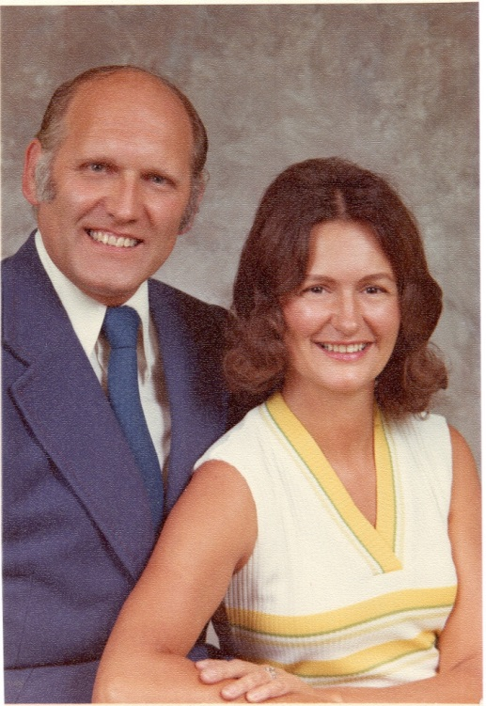

Slide 3
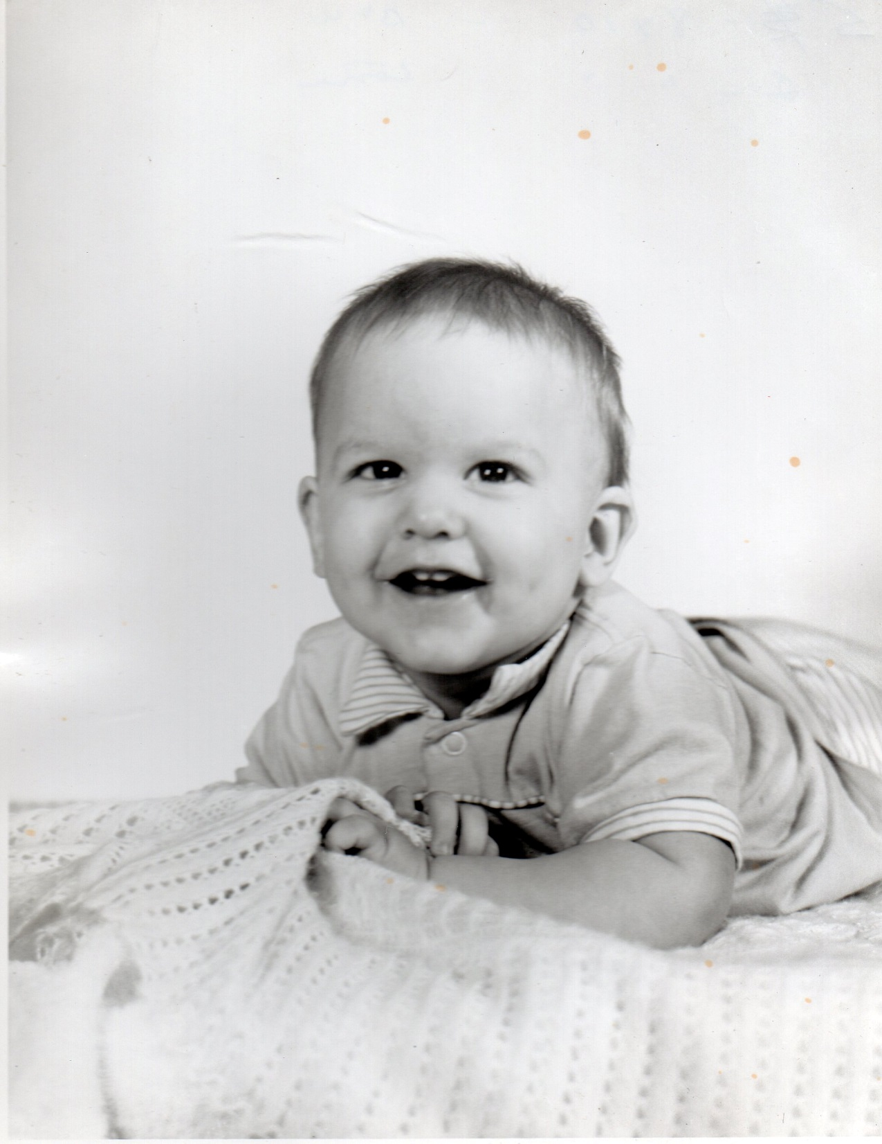

Slide 4
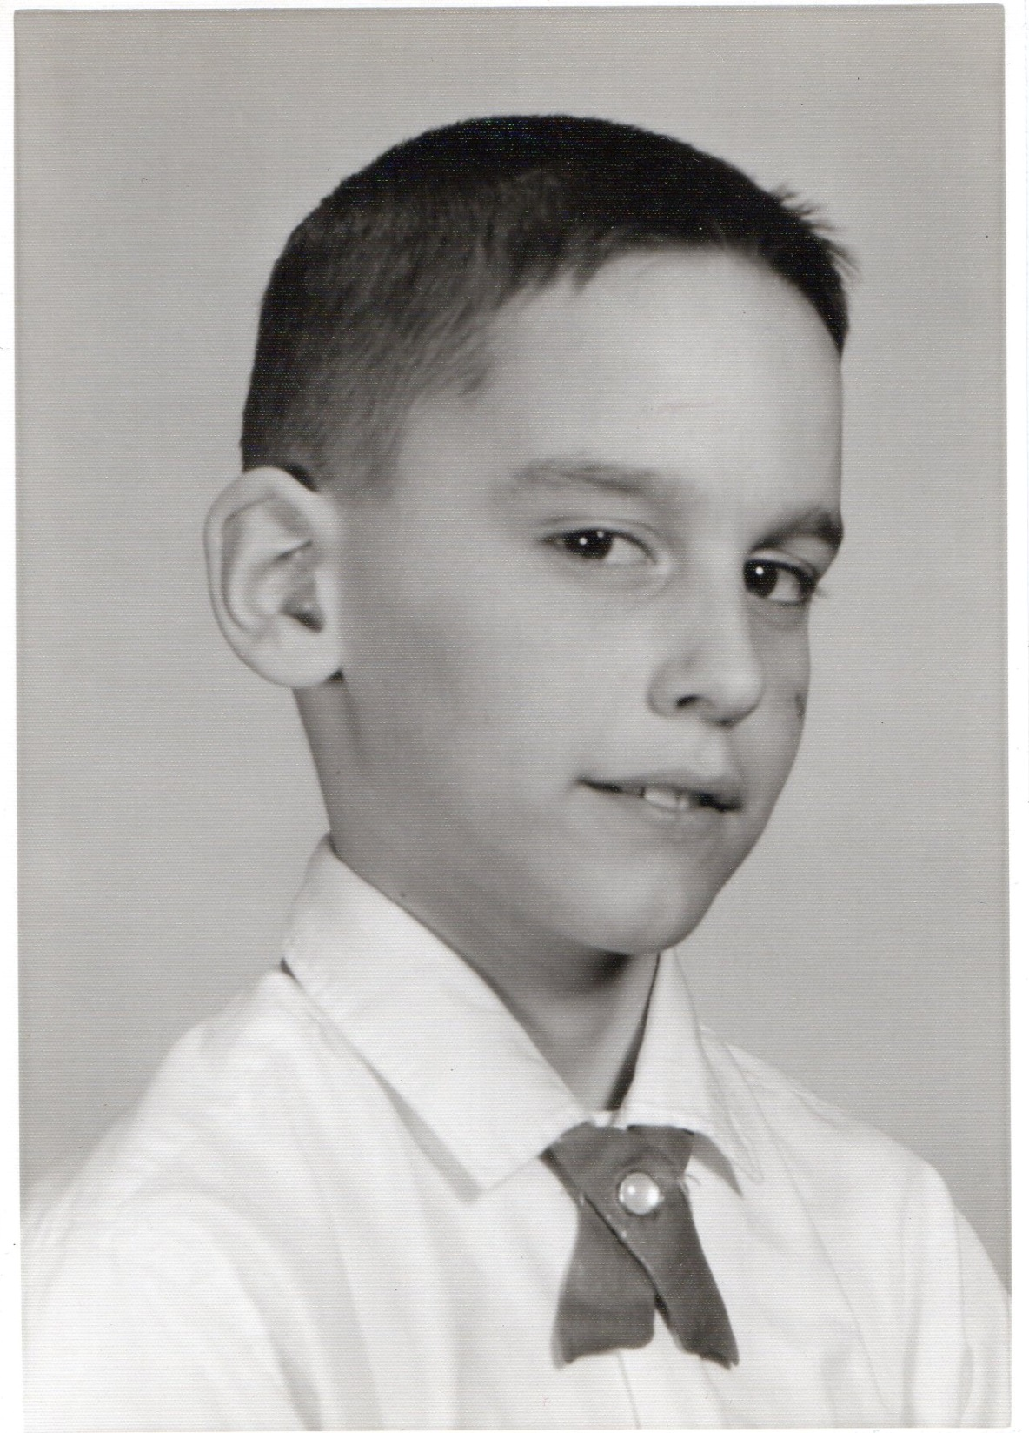

Slide 5
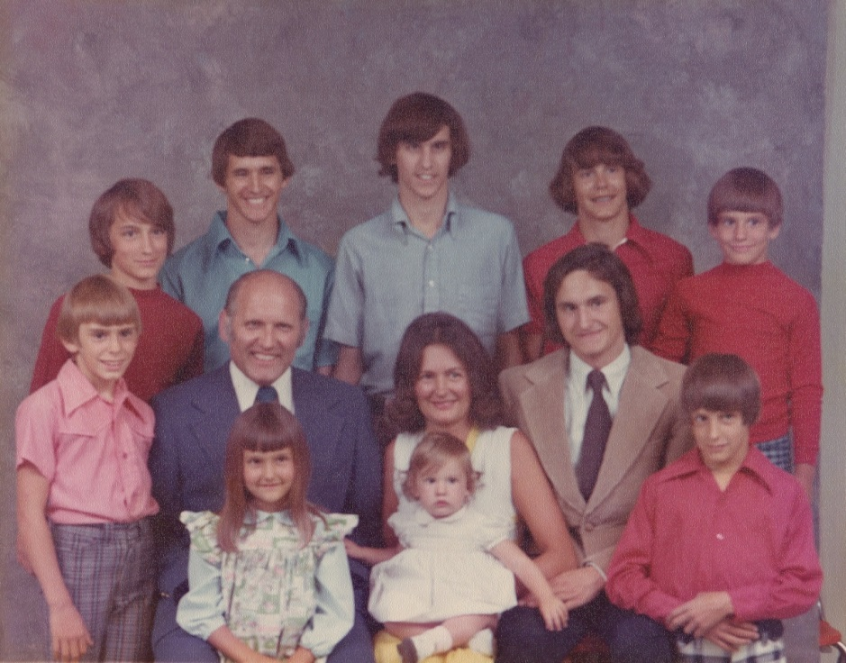

Slide 6
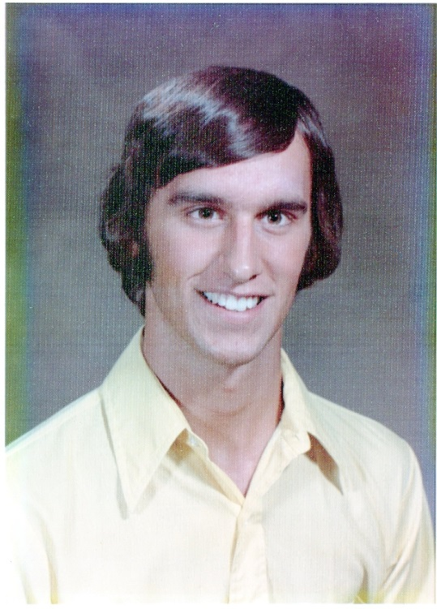

Slide 7
Romans 5:8 (NLT)
⁸ But God showed his great love for us by sending Christ to die for us while we were still sinners.

Slide 8
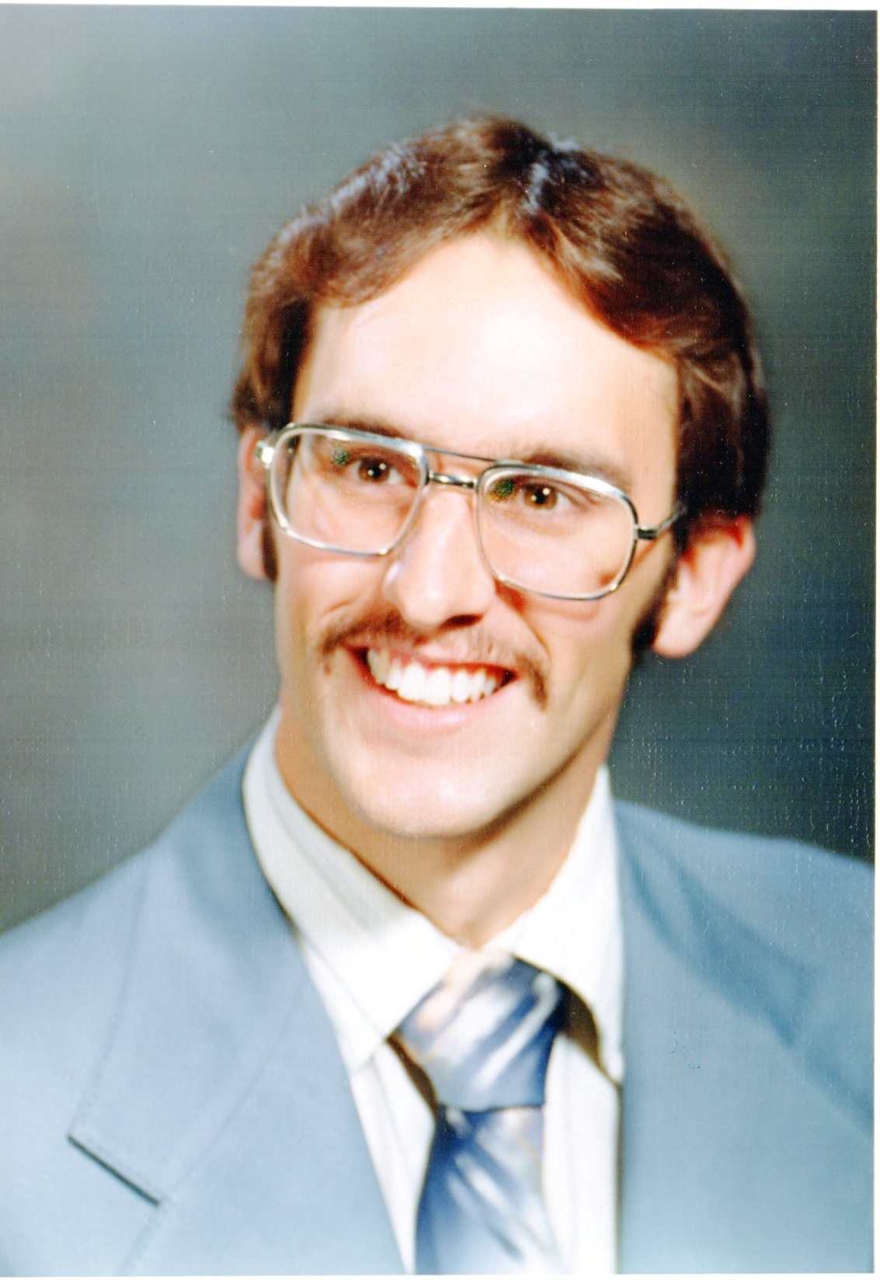

Slide 9
Why do we give of our money?

Slide 10
Three Foundational Principles
We do everything for God’s Glory
We do it as a way of loving God
We do it as a way of loving our neighbor

Slide 11
Malachi 3:10 (NLT)
¹⁰ Bring all the tithes into the storehouse so there will be enough food in my Temple. If you do,” says the Lord of Heaven’s Armies, “I will open the windows of heaven for you. I will pour out a blessing so great you won’t have enough room to take it in! Try it! Put me to the test!

Slide 12
Three Foundational Principles
We do everything for God’s Glory
We do it as a way of loving God
We do it as a way of loving our neighbor

Slide 13
When I began tithing…
It didn’t bring God glory but to ME
I didn’t love God or my neighbor more
I loved ME more for MY generosity
I wasn’t being a steward of God’s money,
but a proud giver of MY money

Slide 15
Matthew 6:19-21 (NLT)
¹⁹ “Don’t store up treasures here on earth, where moths eat them and rust destroys them, and where thieves break in and steal. ²⁰ Store your treasures in heaven, where moths and rust cannot destroy, and thieves do not break in and steal. ²¹ Wherever your treasure is, there the desires of your heart will also be.

Slide 16
Matthew 6:24 (NLT)
²⁴ “No one can serve two masters. For you will hate one and love the other; you will be devoted to one and despise the other. You cannot serve both God and money.

Slide 17
Hebrews 13:5 (NLT)
⁵ Don’t love money; be satisfied with what you have. For God has said,
“I will never fail you.
I will never abandon you.”

Slide 18
1 Timothy 6:10 (NLT)
¹⁰ For the love of money is the root of all kinds of evil. And some people, craving money, have wandered from the true faith and pierced themselves with many sorrows.

Slide 19
2 Corinthians 9:7-8 (NLT)
⁷ You must each decide in your heart how much to give. And don’t give reluctantly or in response to pressure. “For God loves a person who gives cheerfully.”
⁸ And God will generously provide all you need. Then you will always have everything you need and plenty left over to share with others.

Slide 20
2 Corinthians 9:11 (NLT)
¹¹ Yes, you will be enriched in every way so that you can always be generous. And when we take your gifts to those who need them, they will thank God.

Slide 21
2 Corinthians 9:12-13 (NLT)
¹² So two good things will result from this ministry of giving—the needs of the believers in Jerusalem will be met, and they will joyfully express their thanks to God.
¹³ As a result of your ministry, they will give glory to God. For your generosity to them and to all believers will prove that you are obedient to the Good News of Christ.

Slide 22
Three Foundational Principles
We do everything for God’s Glory
We do it as a way of loving God
We do it as a way of loving our neighbor

Slide 23
Luke 6:30 (NLT)
³⁰ Give to anyone who asks; and when things are taken away from you, don’t try to get them back.

Slide 24
Deuteronomy 15:10 (NLT)
¹⁰ Give generously to the poor, not grudgingly, for the Lord your God will bless you in everything you do.

Slide 25
2 Corinthians 8:1-15 (NLT)
¹ Now I want you to know, dear brothers and sisters, what God in his kindness has done through the churches in Macedonia. ² They are being tested by many troubles, and they are very poor. But they are also filled with abundant joy, which has overflowed in rich generosity.

Slide 26
2 Corinthians 8:1-15 (NLT)
³ For I can testify that they gave not only what they could afford, but far more. And they did it of their own free will. ⁴ They begged us again and again for the privilege of sharing in the gift for the believers in Jerusalem. ⁵ They even did more than we had hoped, for their first action was to give themselves to the Lord and to us, just as God wanted them to do.

Slide 27
2 Corinthians 8:1-15 (NLT)
⁶ So we have urged Titus, who encouraged your giving in the first place, to return to you and encourage you to finish this ministry of giving. ⁷ Since you excel in so many ways—in your faith, your gifted speakers, your knowledge, your enthusiasm, and your love from us—I want you to excel also in this gracious act of giving.

Slide 28
2 Corinthians 8:1-15 (NLT)
⁸ I am not commanding you to do this. But I am testing how genuine your love is by comparing it with the eagerness of the other churches.
⁹ You know the generous grace of our Lord Jesus Christ. Though he was rich, yet for your sakes he became poor, so that by his poverty he could make you rich.

Slide 29
2 Corinthians 8:1-15 (NLT)
¹⁰ Here is my advice: It would be good for you to finish what you started a year ago. Last year you were the first who wanted to give, and you were the first to begin doing it. ¹¹ Now you should finish what you started. Let the eagerness you showed in the beginning be matched now by your giving. Give in proportion to what you have.

Slide 30
2 Corinthians 8:1-15 (NLT)
¹² Whatever you give is acceptable if you give it eagerly. And give according to what you have, not what you don’t have. ¹³ Of course, I don’t mean your giving should make life easy for others and hard for yourselves. I only mean that there should be some equality.

Slide 31
2 Corinthians 8:1-15 (NLT)
¹⁴ Right now you have plenty and can help those who are in need. Later, they will have plenty and can share with you when you need it. In this way, things will be equal. ¹⁵ As the Scriptures say,
“Those who gathered a lot had nothing left over, and those who gathered only a little had enough.”

Slide 32
Three Foundational Principles
We do everything for God’s Glory
We do it as a way of loving God
We do it as a way of loving our neighbor

Slide 33
2 Corinthians 8:1-15 (NLT)
¹ Now I want you to know, dear brothers and sisters, what God in his kindness has done through the churches in Macedonia. ² They are being tested by many troubles, and they are very poor. But they are also filled with abundant joy, which has overflowed in rich generosity.

Slide 34
2 Corinthians 8:1-15 (NLT)
³ For I can testify that they gave not only what they could afford, but far more. And they did it of their own free will. ⁴ They begged us again and again for the privilege of sharing in the gift for the believers in Jerusalem. ⁵ They even did more than we had hoped, for their first action was to give themselves to the Lord and to us, just as God wanted them to do.

Slide 35
2 Corinthians 8:1-15 (NLT)
⁶ So we have urged Titus, who encouraged your giving in the first place, to return to you and encourage you to finish this ministry of giving. ⁷ Since you excel in so many ways—in your faith, your gifted speakers, your knowledge, your enthusiasm, and your love from us—I want you to excel also in this gracious act of giving.

Slide 36
2 Corinthians 8:1-15 (NLT)
⁸ I am not commanding you to do this. But I am testing how genuine your love is by comparing it with the eagerness of the other churches.
⁹ You know the generous grace of our Lord Jesus Christ. Though he was rich, yet for your sakes he became poor, so that by his poverty he could make you rich.

Slide 37
2 Corinthians 8:1-15 (NLT)
¹⁰ Here is my advice: It would be good for you to finish what you started a year ago. Last year you were the first who wanted to give, and you were the first to begin doing it. ¹¹ Now you should finish what you started. Let the eagerness you showed in the beginning be matched now by your giving. Give in proportion to what you have.

Slide 38
2 Corinthians 8:1-15 (NLT)
¹² Whatever you give is acceptable if you give it eagerly. And give according to what you have, not what you don’t have. ¹³ Of course, I don’t mean your giving should make life easy for others and hard for yourselves. I only mean that there should be some equality.

Slide 39
2 Corinthians 8:1-15 (NLT)
¹⁴ Right now you have plenty and can help those who are in need. Later, they will have plenty and can share with you when you need it. In this way, things will be equal. ¹⁵ As the Scriptures say,
“Those who gathered a lot had nothing left over, and those who gathered only a little had enough.”

Slide 40
1 Timothy 6:6-8 (NLT)
⁶ Yet true godliness with contentment is itself great wealth. ⁷ After all, we brought nothing with us when we came into the world, and we can’t take anything with us when we leave it. ⁸ So if we have enough food and clothing, let us be content.

Slide 41
Mark 12:41-44 (NLT)
⁴¹ Jesus sat down near the collection box in the Temple and watched as the crowds dropped in their money. Many rich people put in large amounts. ⁴² Then a poor widow came and dropped in two small coins.

Slide 42
Mark 12:41-44 (NLT)
⁴³ Jesus called his disciples to him and said, “I tell you the truth, this poor widow has given more than all the others who are making contributions. ⁴⁴ For they gave a tiny part of their surplus, but she, poor as she is, has given everything she had to live on.”

Slide 44
Three Foundational Principles
We do everything for God’s Glory
We do it as a way of loving God
We do it as a way of loving our neighbor

Slide 46
Luke 6:38 (NLT)
³⁸ Give, and you will receive. Your gift will return to you in full—pressed down, shaken together to make room for more, running over, and poured into your lap. The amount you give will determine the amount you get back.”

Slide 47
2 Peter 2:1-3 (NLT)
¹But there were also false prophets in Israel, just as there will be false teachers among you. They will cleverly teach destructive heresies and even deny the Master who bought them. In this way, they will bring sudden destruction on themselves.

Slide 48
2 Peter 2:1-3 (NLT)
² Many will follow their evil teaching and shameful immorality. And because of these teachers, the way of truth will be slandered. ³ In their greed they will make up clever lies to get hold of your money. But God condemned them long ago, and their destruction will not be delayed.

