Slide 1
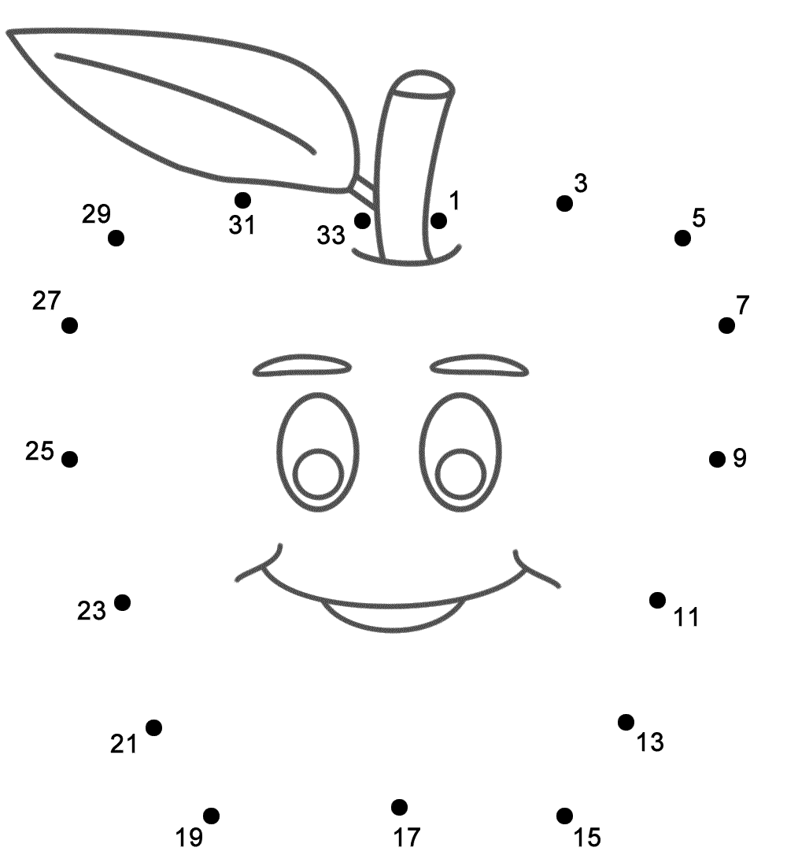

Slide 2
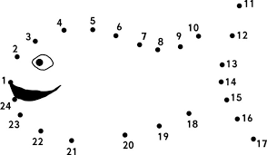

Slide 3
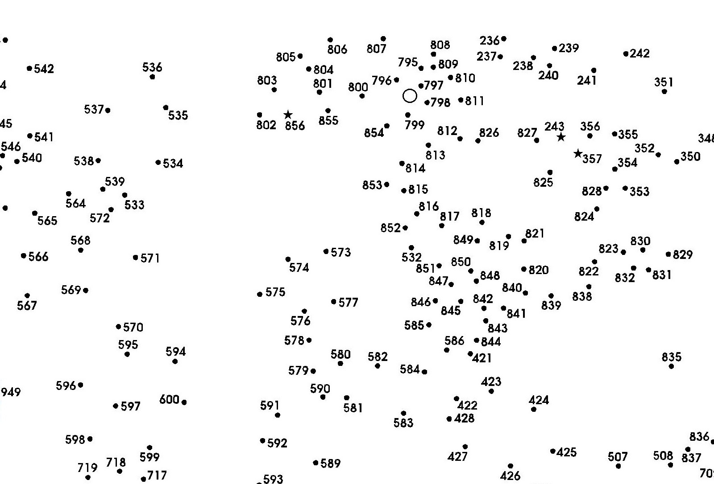

Slide 4
Connecting the Dots
Galatians 3:1-14

Slide 5
Context
The Galatian believers were in the process of defecting from the gospel
  Turning from grace to the Law
Paul wrote to rebuke them and get them back on track

Slide 6
Context
No one, Jew or Gentile, is made acceptable to God by the works of the Law
  In fact, Jewish Christians had to die to the Law to be alive to God

Slide 7
Context
If Jews had to die to the Law to become Christians, why would Gentiles have to become Jewish to become Christians?

Slide 8
Context
If anyone could be made acceptable to God by works of the Law then Christ died needlessly

Slide 9
Context
Peter’s actions were inconsistent with the truth of the gospel, and Paul confronted him about it (2:11-21)
The Galatians’ actions were also inconsistent with the gospel

Slide 10
Connect the Dots
You foolish Galatians, who has bewitched you…?
JB Phillips: “O you dear idiots of Galatia…”

Slide 11
Connect the Dots
Foolish?
  Luke 24:25 – road to Emmaus
  From noeo: to perceive with the mind, not the senses; apprehend (Rom. 1:20; Matt. 16:5-12)

Slide 12
Connect the Dots
Foolish – without comprehension
  They did not ‘connect the dots’
  Mental / spiritual laziness
  They should have known better

Slide 13
Connecting the Dots
Dot: if righteousness comes through the Law, then Christ died needlessly
Dot: Christ was clearly portrayed as crucified for a reason
Therefore…

Slide 14
Connecting the Dots
Dot: Only those accepted by God have the Holy Spirit (Rom. 8:9-10)
Dot: Did you receive the Spirit by works of the Law or by faith?
Therefore…

Slide 15
Connecting the Dots
Dot: This started as a spiritual matter by faith
Dot: Why would it then be completed by works of the Law?

Slide 16
Connecting the Dots
Dot: God has lavishly given you His Spirit and worked miracles
Dot: Did He do that because of works of the Law or your faith?
Therefore…

Slide 17
R. Alan Cole
“While it is true that, for Paul, spiritual things are spiritually discerned (1 Cor. 2:14), it is equally true … that theology for him is nothing more than the ordinary rules of grammar and logic applied to the text of Scripture.”

Slide 18
Connecting the Dots
Paul’s judgment: foolish Galatians!
  Is this fair?
  How/why?
  What are the implications of this?

Slide 19
So What?
Take a bite
Chew
Swallow

Slide 20
1. Take a Bite
You have to get spiritual truth inside
  Read/study the Bible for yourself
Notes:
LBTB, pg 30

Slide 21
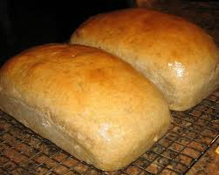
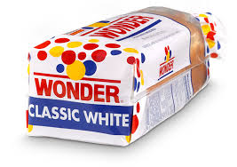
Which is Better?
Fresh
Pre-Packaged
Notes:
LBTB, pg 30

Slide 22
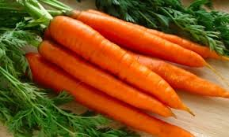
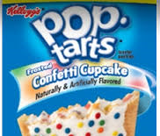
Which is Better?
Fresh
Pre-Packaged
Notes:
LBTB, pg 30

Slide 23
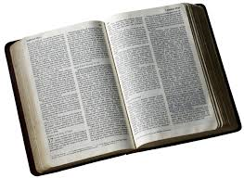
Which is Better?
Fresh
Pre-Packaged
Notes:
LBTB, pg 30

Slide 24
2. Chew
Meditate on spiritual truth
  Prayerfully ruminate
    Ps. 1:1-3; Josh. 1:8; Ps. 119
  Don’t regurgitate, cogitate

Slide 25
2. Chew
Meditate on spiritual truth
  Chew on tough things
    2 Tim. 2:1-7 (noeo)

Slide 26
2. Chew
Meditate on spiritual truth
  Ask for insight, understanding, comprehension, discernment
    Phil. 1:9-11; Col. 1:9-12; James 1:5-8

Slide 27
3. Swallow
Put it into action
  Heb. 5:14 – practice (constant use)
  2 Tim. 3:16-17 – training in righteousness

Slide 28
Yeah But…
It’s hard!
  “Scripture does not yield its fruit to the lazy.” H. Hendricks
Prov. 2:1-8

