Slide 1
What rules did your parents have in your house?
What rules do you have in yours?
Why did our parents make rules?
Why do we?

Slide 2
Why the Law Then?
Galatians 3:10-22

Slide 3
Galatians 3:10-22
The Big Question:
How is anyone made
acceptable to God?

Slide 4
Galatians 3:10-22
The Law and the People
The Law and the Promise
The Law and the Plan

Slide 5
The Law and the People (10-14)
Connecting the Dots:
Trying to keep the Law brings a curse - Deut. 27:26 + 28:1
No one is justified by the Law - Hab. 2:4

Slide 6
The Law and the People (10-14)
Self-righteousness and faith are mutually exclusive - Lev. 18:5
Christ redeemed us from the curse - Deut. 21:23

Slide 7
The Law and the People (10-14)
The Law brings a curse (10-12)
Jesus took the curse (13)
Then through faith we receive the blessing of Abraham: the Holy Spirit (14)

Slide 8
The Law and the Promise (15-18)
Example: a covenant
  Once in place, it cannot be ignored or amended
  God (by Himself) made a covenant with Abraham (Gen. 15)

Slide 9
The Law and the Promise (15-18)
Example: a covenant
  The beneficiaries of the covenant were Abraham and his ‘seed’
  The Law, given later, does not negate or amend the covenant

Slide 10
The Law and the Plan (19-22)
So, if the Law:
  cannot make anyone acceptable
  only brings a curse
  does not negate the promise …

Slide 11
The Law and the Plan (19-22)
Then…
Why the Law?

Slide 12
The Law and the Plan (19-22)
Added because of transgressions
  What does ‘gress’ mean?
    Go, walk, step
  Transgress = step by the side, deviate, violate the law

Slide 13
The Law and the Plan (19-22)
Added because of transgressions
  To restrain sin (e.g. Deut. 19:15-21)
  To make sin obvious (e.g. Rom. 7)
    Example: The bathroom stool

Slide 14
The Law and the Plan (19-22)
The Law cannot make someone acceptable, it only reveals what is and is not acceptable

Slide 15
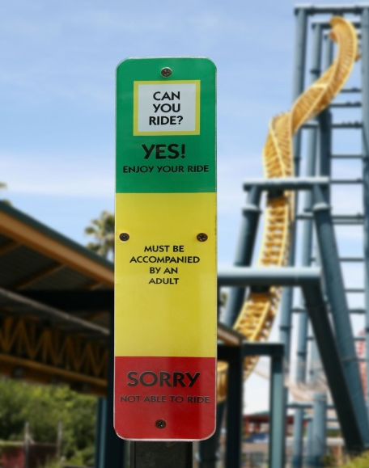
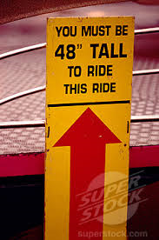

Slide 16
The Law and the Plan (19-22)
The Law cannot make someone acceptable, it only reveals what is and is not acceptable
We are fundamentally flawed from the start, and we can’t keep the Law

Slide 17
R. Alan Cole
“Indeed, there are times when Paul boldly says that the function of the law is to teach us the moral bankruptcy of fallen humanity. He does not mean that the law makes us sinners, but that it shows us to be sinners.”
Notes:
Galatians, pg 149

Slide 18
The Pulpit Commentary
“The main difficulty in producing a moral reformation among men is to convince them of their degradation – of the low level to which they have sunk. …

Slide 19
The Pulpit Commentary
The first thing to be done is to hold up to their view some bright mirror, in the which they may discern clearly what manner of man they are.”

Slide 20
The Law and the Plan (19-22)
If the Law could make someone acceptable to God, then acceptableness could be earned (21)
Everyone is a transgressor!
The promise only comes by faith (22)

Slide 21
So What? (Or, The Law and Us)
Everyone stands condemned (22) (Rom. 1-2; Acts 17:30)
Our only hope is to humble ourselves and come to God in faith

Slide 22
So What? (Or, The Law and Us)
The Law teaches us about the character of God
  Why is lying wrong?
  Why is murder wrong?
Connect the dots

Slide 23
So What? (Or, The Law and Us)
“The commandments of God are given to provide us practical knowledge of the character and nature of God and how to live in relationship to Him. … The laws He gives flow out of who He is.”
(Josh McDowell – Right from Wrong)
Notes:
Right from wrong, pg 91

Slide 24
So What? (Or, The Law and Us)
The Law teaches us how to live right (2 Tim. 3:16-17; e.g. 1 Cor. 10)
The Law teaches us how to love God
  The greatest commandment?
  Deut. 6:1-9; 10:12-13

