Slide 1
The Heart of Ministry
Galatians 4:12-20

Slide 2
Galatians 4:12-20
Petition
Rejection
Intention

Slide 3
Petition
“I beg of you, brethren” (12)
  From arguments to appeal
  Pleading to recognize the truth and turn from error

Slide 4
Petition
“become as I am” (12)
  He was dead to the Law (2:14-21)
  He was acceptable to God by faith, not by works (2:15-16)

Slide 5
So What?
Any hint of self-righteousness?
  “At least I’m better than that person” or “that group”
  “At least I’m not like them”

Slide 6
Rejection
At first they received him admirably
  Illness / condition?
    Trial / despise / loathe
  As an angel or Jesus Himself!

Slide 7
Rejection
At first they received him admirably
Now they are turning away
  ‘Where is that sense of blessing?’
  ‘You would have plucked out your eyes’

Slide 8
Rejection
“So have I become your enemy by telling you the truth?”
  Why would people reject someone who tells them the truth?
  What does this presuppose?

Slide 9
So What?
What’s the danger of believing something that might not be true?
Is it wrong to question or challenge another’s beliefs?

Slide 10
So What?
One measure of spiritual maturity is the knowledge of what is true, not skepticism, doubt, or ambiguity
We need to speak truth to one another (Eph. 4:13-15; 5:19)

Slide 11
Intention
‘They seek you so you will seek them’
  ‘eagerly seek’ – courting
  Self-serving, self-promoting
  MLM

Slide 12
Intention
‘I seek you so you will seek Him’
  I am again in labor
    Like a woman who gave birth once but now has to go through labor again with the same child

Slide 13
Intention
‘I seek you so you will seek Him’
  Until Christ is formed in you
    to give outward expression to one’s inward nature
    ‘Shaped’ vs ‘Formed’

Slide 14
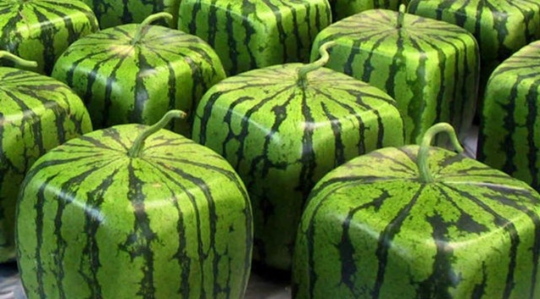

Slide 15
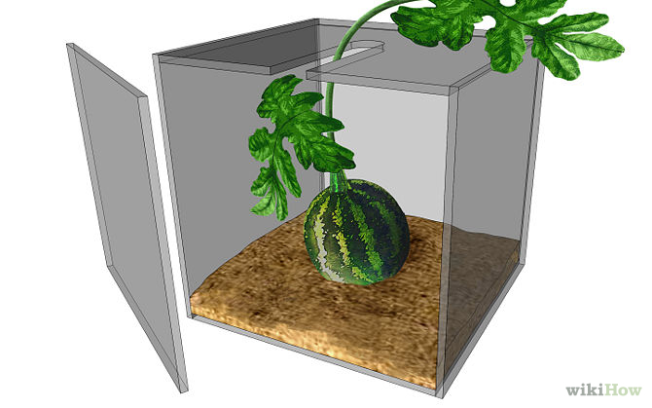

Slide 16
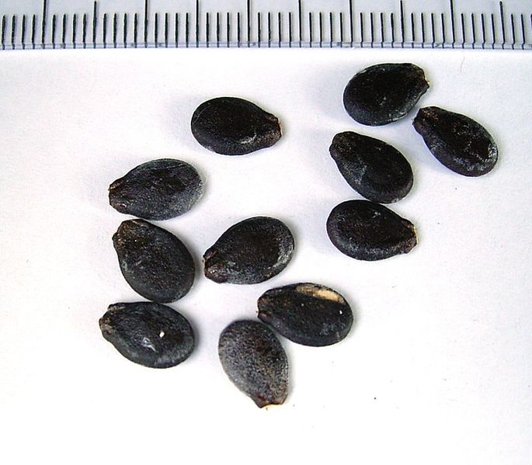
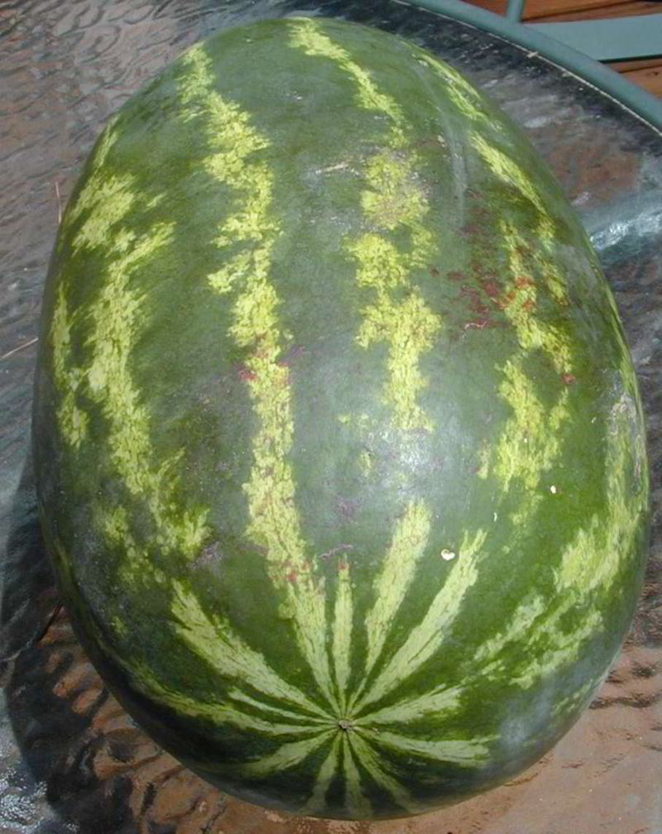

Slide 17
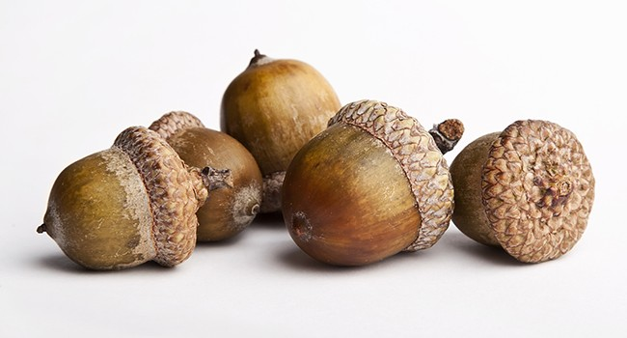
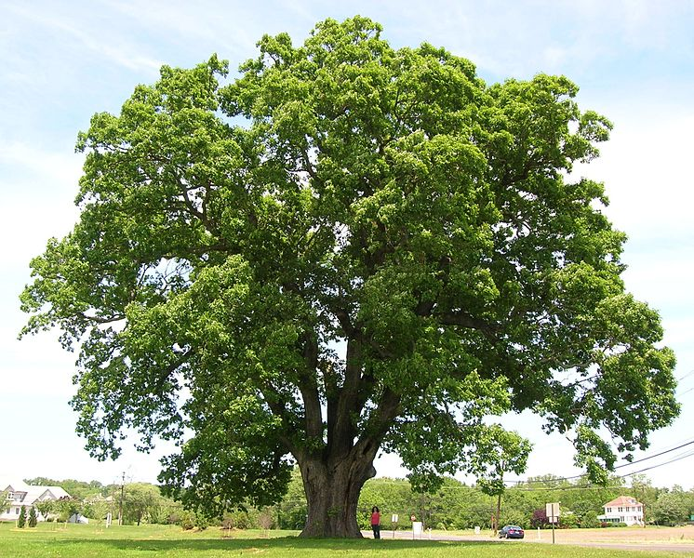

Slide 18
Religion
Legalism
Self-Righteousness

Slide 19
Intention
‘I seek you so you will seek Him’
  Until Christ is formed in you
    Our behavior now should be consistent with our new character

Slide 20
Intention
Paul’s goal for everyone: Col. 1:28-29
  Proclaim Christ
  Admonish – warn, call to repent
  Teaching – instruct in doctrine

Slide 21
Intention
Paul’s Goal for everyone: Col. 1:28-29
  Complete – mature, brought to its intended full development

Slide 22
Intention
“I am perplexed about you”
  At his wit’s end
  Concerned about their faithfulness and growth

Slide 23
So What?
Love and compassion will move us to correct error
We should be constantly laboring to make others complete in Christ (proclaim, admonish, instruct)

