Slide 1
Have you heard of a
Medical Zebra?

Slide 2
Wikipedia: Zebra
“…in the late 1940s … Dr. Theodore Woodward, professor at the University of Maryland School of Medicine, … instructed his medical interns: "When you hear hoofbeats, think of horses not zebras".

Slide 3
Wikipedia: Zebra
“Since horses are common in Maryland while zebras are relatively rare, logically one could confidently guess that an animal making hoofbeats is probably a horse.”

Slide 4
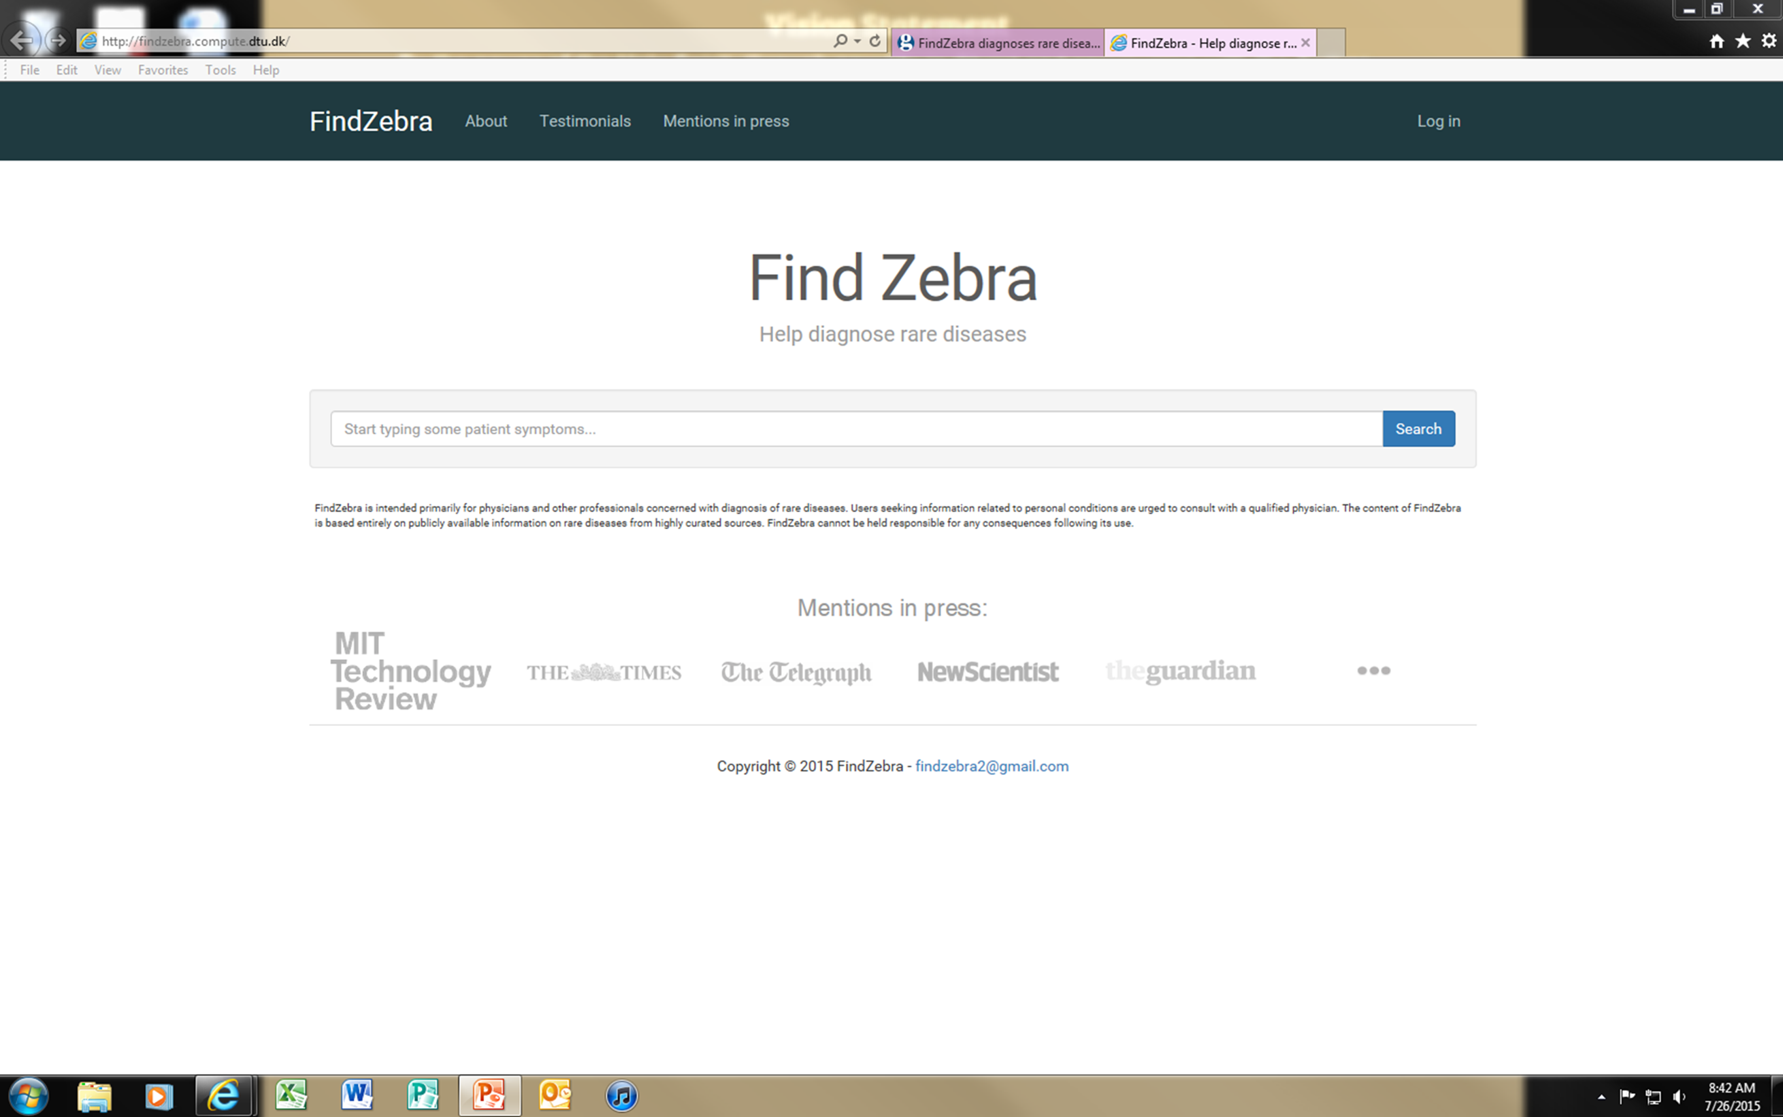

Slide 5
Walking in Freedom
Galatians 5:16-18

Slide 6
Galatians 5:16-23
Freedom of Choice
Walking by the Spirit

Slide 7
Freedom of Choice
The Law provided a standard by which to judge behavior
Christ set us free from the Law
If we are free from the Law, how do we judge? What’s the standard?

Slide 8
Freedom of Choice
Freedom means loving servitude, not indulgence of the flesh
In fact, try this standard: “You shall love your neighbor as yourself.”
Biting + Devouring ≠ Loving

Slide 9
Freedom of Choice
One aspect of your freedom is the freedom to choose
  Your choice is between the Spirit and the flesh as controlling principles

Slide 10
Freedom of Choice
If you choose one you automatically reject the other
  They are polar opposites
  They are at war!

Slide 11
Freedom of Choice
“you may not do the things that you please”
  Always want the other?
    Whichever you choose, the other is unhappy

Slide 12
Freedom of Choice
“you may not do the things that you please”
  Explaining the tension?
    Rom. 7:14-25; James 1:13-15

Slide 13
Freedom of Choice
“you may not do the things that you please”
  You may really want to sin, but if you obey the Spirit you won’t ‘carry out the desire of the flesh’

Slide 14
Freedom of Choice
What’s the standard?
  If you are following the Spirit, you are not under the Law but are fulfilling the Law (see 14)

Slide 15
Freedom of Choice
How do
we know?

Slide 16
Freedom of Choice
Diagnostic symptoms
  This is what ‘walking in the flesh’ looks like (19-21)
  This is what ‘walking by the Spirit’ looks like (22-23)

Slide 17
Freedom of Choice
Diagnostic symptoms
  ‘This is what it looks like’ -- not: ‘This is how to do it’
  Keep in mind: choices have consequences (21; 6:7-8)

Slide 18
Freedom of Choice
What’s the
prescription?

Slide 19
Walk
By the Spirit – Gal. 5:16
Worthy of the calling – Eph. 4:1
No longer as the Gentiles – Eph. 4:17
In love – Eph. 5:2

Slide 20
Walk
As children of Light – Eph. 5:8
Carefully – Eph. 5:15
As wise men – Eph. 5:15
Worthy of the Lord – Col. 1:10

Slide 21
Walk
Following instructions – 1 Thess. 4:1
In newness of life – Rom. 6:4
According to the Spirit – Rom. 8:4

Slide 22
Ephesians 2:1-10
We formerly walked in sin (the flesh)
God made us alive (GRACE!)
Now we are to walk in good works

Slide 23
Ephesians 4:17-5:21
Don’t walk in sin (the flesh)
Be renewed
Imitate God

Slide 24
Colossians 3:1-17
Put the flesh to death
Be renewed
Put on… (the fruit of the Spirit)

Slide 25
Charles McDougall
“The central theme of ‘walking’ in these passages seems to be an active, volitional living out of the truth Paul had taught them. It is not merely an internal redemption, but one that is outwardly manifest in ongoing, specific choices.”

Slide 26
G. Walter Hansen
“Only the power of the Spirit at work in us can enable us to overcome sin and fulfill God’s moral design for our lives through loving service to others.”
Notes:
Pg. 167

Slide 27
So What?
As obedient children, do not be conformed to the former lusts which were yours in your ignorance, but like the Holy One who called you, be holy yourselves also in all your behavior; because it is written, “You shall be holy, for I am holy.” (1 Pet. 1:14-16)

Slide 28
So What?
Examine your actions and reactions (5:19-23; Eph. 4:31-32; 5:3-10)
In the power of the Holy Spirit:
  Put off the old – Put on the new (Eph. 4:25-32; Col. 3:12-17)

