Slide 1
W.A.L.K.
Galatians 5:19-25

Slide 2
Galatians 5:24-25
And those who belong to Christ Jesus have crucified the flesh with its passions and desires. If we live by the Spirit, let us also walk by the Spirit.

Slide 3
W.A.L.K.
Washed in the Blood (v. 24)
To WALK in the Spirit, we must first be found IN Christ
To WALK in the Spirit, we must continually trust Christ

Slide 4
W.A.L.K.
Aligned By (and with) the Spirit
(vv. 16-18)
To WALK in the Spirit we must allow the Spirit to do work
To WALK in the Spirit, we must allow the Spirit to lead

Slide 5
W.A.L.K.
Leave it & Live it (vv. 19-23)
To WALK in the Spirit we must leave the desires of the flesh
To WALK in the Spirit, we must let Christ live

Slide 6
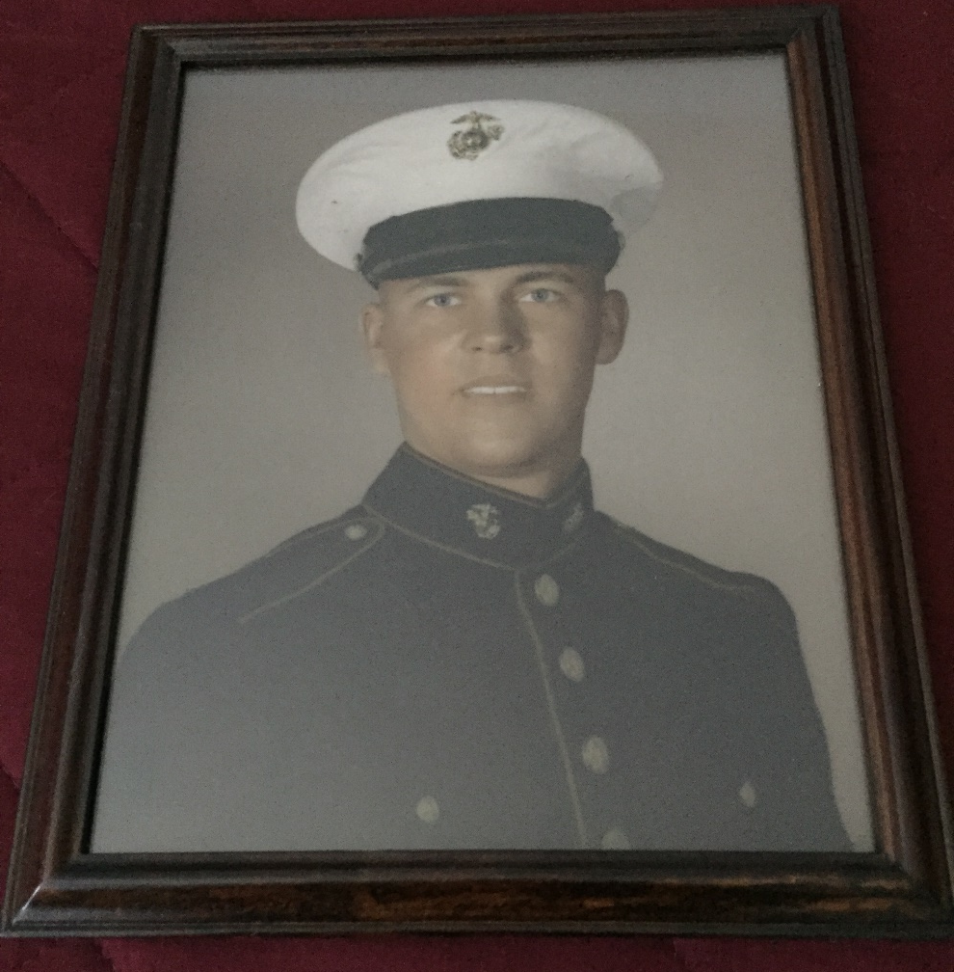
W.A.L.K.
Keep
Step (v. 25)

Slide 7
W.A.L.K.
Keep Step (v. 25)
To WALK in the Spirit we must rely on His life and strength
To WALK in the Spirit, we must follow His call and command

Slide 8
Washed in the Blood
Aligned By (and with) the Spirit
Leave it & Live it
Keep Step

