Slide 1
Have you ever felt lost?
Have you ever felt confused?
Have you ever felt depressed?
Have you ever felt like you just don’t understand life?

Slide 2
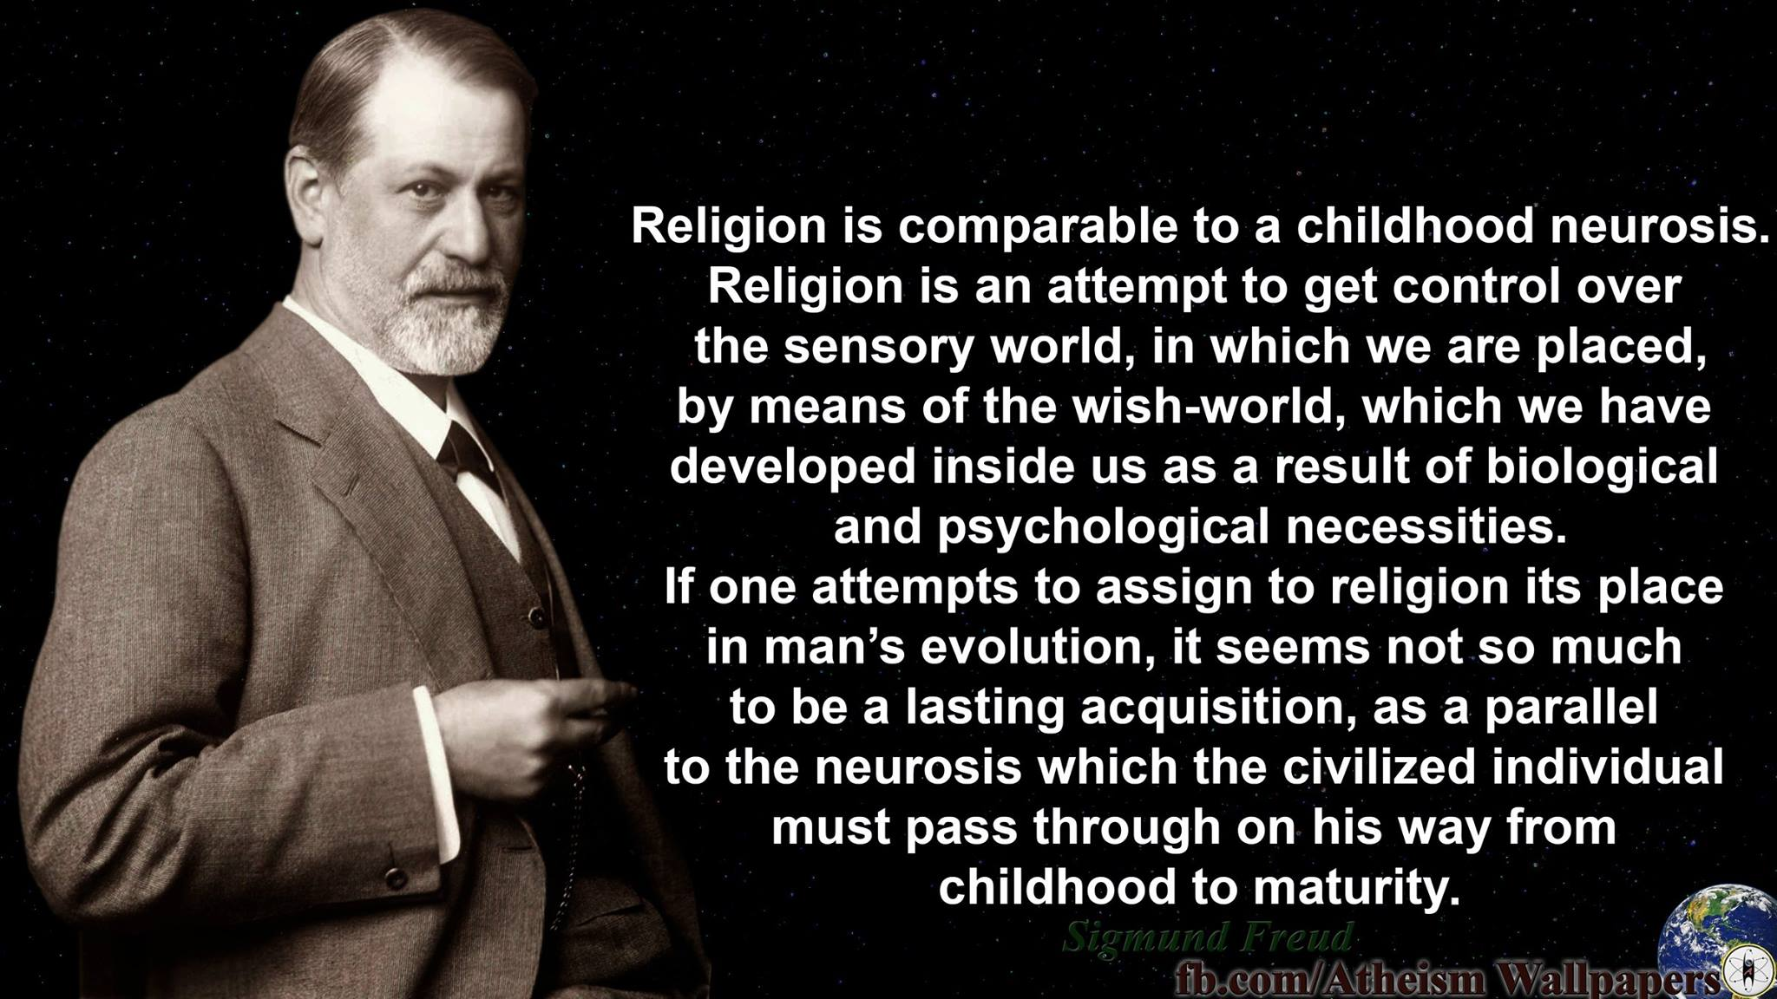

Slide 4
A Biblical Worldview and the
Care of the Soul
Psalm 19

Slide 5
Psalm 19
Magnificent Creator (1-6)
Beneficent Law-giver (7-11)
Humble Follower (12-14)

Slide 6
Magnificent Creator
The Heavens
  Day to Day and Night to Night
    Systematic orderliness
    Cosmos; Cosmology

Slide 7
Magnificent Creator
Communicates (1-3) – telling, etc.
  Coherent - Rom. 1:18-20
Comprehensive (4-6) – available to every human being
  Condemning – Rom. 1:21-25

Slide 8
Magnificent Creator
The heavens point to ‘God’
  El – the Mighty, or Almighty
  God as Creator – 1 Chron. 16:24-29; Neh. 9:5b-6; Acts 14:14-18; Rev. 14:6-7

Slide 9
Magnificent Creator
The heavens point to ‘God’
  His glory, nature, dominion, power, wisdom, majesty, beauty, wrath, etc.
  But more is needed…

Slide 10
Special Revelation
Reveals God’s will, expectations, plan for mankind, counsel on how to live life, how to know Him
  ‘of the Lord’ [YHWH] (6x)
  ‘of God’ [El] (1x)

Slide 11
Beneficent Law-giver
Law, testimony, precepts, commandment, fear, judgments = all of God’s words to man
  Not just the 10 Commandments
  Not just the Mosaic Law

Slide 12
The Words of God
Bring Newness of Life (7a)
  Law – teaching, instruction, rule
  Perfect – complete, whole
  Restoring – transforms us to right living (cf. Rom. 12:2)

Slide 13
The Words of God
Make Us Wise (7b)
  Testimony – witness; warning
  Sure – fixed, firm, trustworthy
  Simple – open: undiscerning
  Wise – skill of living life rightly

Slide 14
The Words of God
Make the Godly Joyful (8a)
  Precepts – obligations for man
  Right – straight, right path
  We are made joyful by living out God’s responsibilities for us

Slide 15
The Words of God
Bring Enlightenment (8b)
  Commandment – statute, edict
  Pure – clean, clear (24:4)
  Enlightening – understanding, light/truth to the intellect

Slide 16
The Words of God
Stand Firm Forever (9a)
  Fear – how to fear God
  Clean – no impurities (12:6)
  God’s way to revere Him will outlast false forms of worship

Slide 17
The Words of God
Above Reproach (9b)
  Judgments – judicial decisions
  True – truth (25:4-5)
  God’s judgments are right, certain, and dependable

Slide 18
Pulpit Commentary
“God’s precepts ‘rejoice the heart’ of the godly. They are not felt as stern commands, but as gracious intimations of what God desires man to do for his own good.”

Slide 19
So What?
In light of what the Word of God is and does, we should desire to know it (10)
… and obey it (11) (James 1:19-25)

Slide 20
Humble Follower
“I fall short. I cannot live up to your expectations perfectly.”
“Please give me grace!” (12)
  Hidden faults – unintended
  Presumptuous sins – willful

Slide 21
Humble Follower
“If you forgive the ones I don’t know, and keep me from the ones I want, then I will be blameless.”
  Noah (Gen 6:8-9); Job (Job 1:1)

Slide 22
Keil & Delitzsch
Great Transgression: “… a collective name for deliberate and reigning, dominant sin, which breaks through man’s relation of favour with God, and consequently casts him out of favour …”
Notes:
Ps. 19, pg 180

Slide 23
Humble Follower
“Help me to live as You would have me live”
  Acceptable – sacrifice
  Rock – stable footing
  Redeemer – Deliverer

