Slide 1
Have you ever been rappelling?

Slide 2
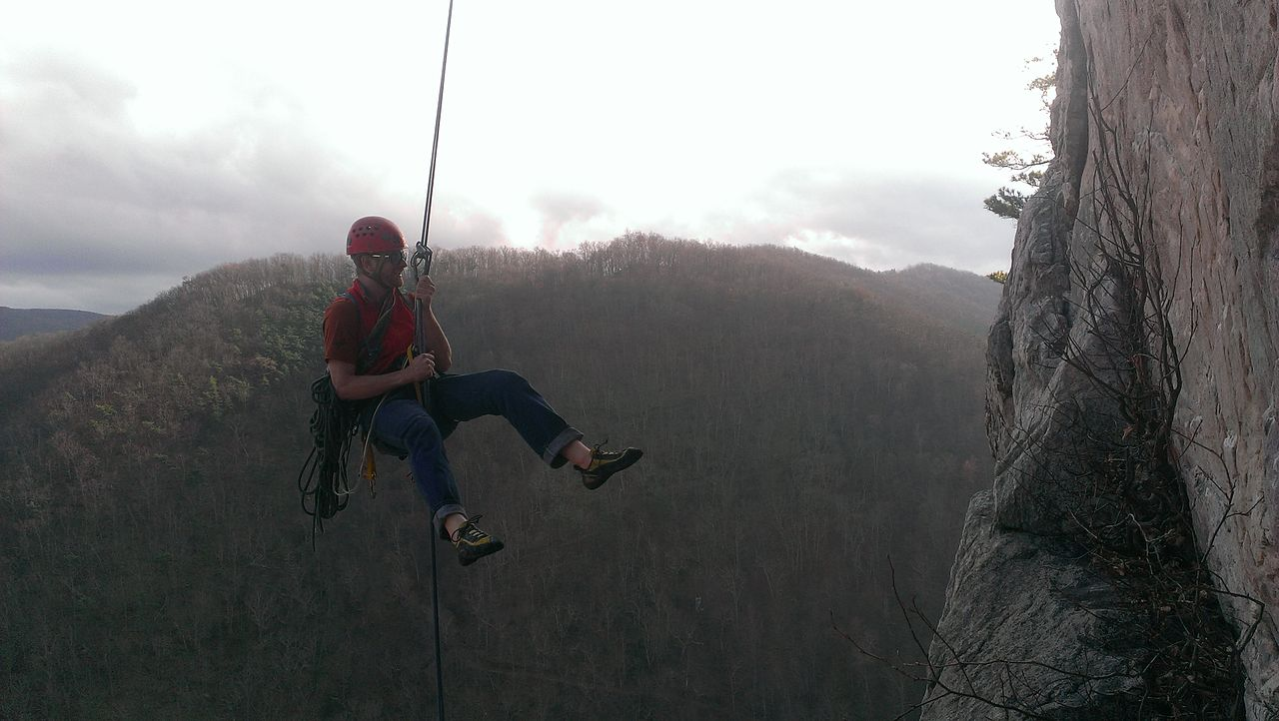

Slide 3
Have you ever wrestled between faith and doubt?
The dad in Mark 9:14-29
Peter in Matt. 14:22-33

Slide 4
Wrestling Faith
Psalm 27

Slide 5
Psalm 27
His Confidence (1-3)
His Craving (4-5)
His Certainty (6)
His Cry (7-10)
His Concern (11-13)
His Counsel (14)

Slide 6
His Confidence
The Lord is my light and my salvation
Lord – YHWH, I Am (Ex. 3:14)
Is – not was, could be, will be
My – not a, their (cf. Ps. 23:1)

Slide 7
His Confidence
Light
Truth – Ps. 43:3
Happiness – Ps. 97:11
Guidance – Ps. 119:105
Understanding – Ps. 119:130

Slide 8
His Confidence
Light
God’s Presence – Ps. 44:3
God’s face / favor – Ps. 89:15
God’s splendor – Ps. 104:1-2

Slide 9
His Confidence
The Lord is my light
Vindication – Ps. 37:6; Micah 7:7-10 (cf. Jer. 51:10)

Slide 10
His Confidence
The Lord is … my salvation
Deliverance – Ex. 14:13
Victory – 2 Chron. 20:17
Preservation – Ps. 62:2, 6, 7

Slide 11
Theological Wordbook of the OT
“Thus salvation … is also the safety and security necessary to maintain life unafraid of numerous dangers.”
Notes:
Yasha (929), pg 415

Slide 12
His Confidence
Whom shall I fear?
“In God I have put my trust, I shall not be afraid. What can man do to me?” Ps. 56:11 (118:6)

Slide 13
His Confidence
The Lord is the defense of my life
Place of refuge
Times of trouble – Ps. 37:39-40
Constant protection

Slide 14
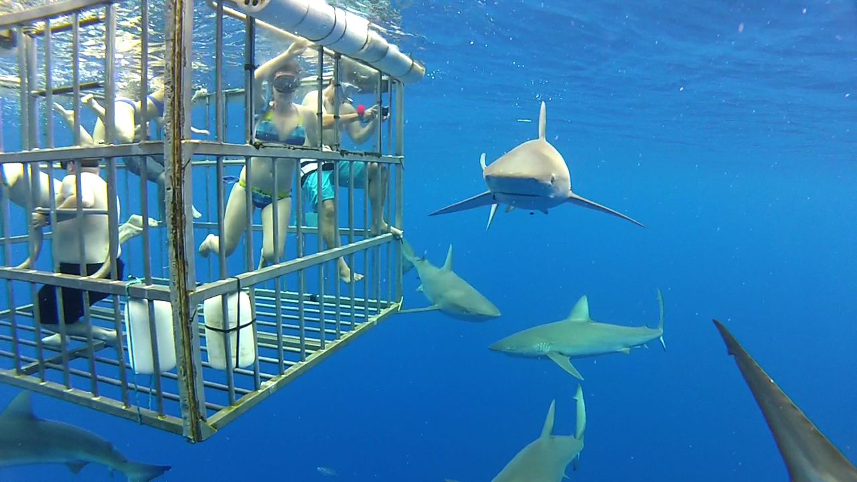

Slide 15
His Confidence
Whom shall I dread?
Sharks? Cannibals? (2)
Eating flesh – Job 19:22
Matt. 5:11-12

Slide 16
His Confidence
Because God proved Himself faithful in the past (2), David had hope in Him for the future (3)

Slide 17
What About Us?
He is the same God (Immutable)
He is still in charge (Sovereign)
He is all-powerful (Omnipotent)
He has a plan for you, which may include suffering (Wise)

Slide 18
What About Us?
God reveals Himself to us through our experiences (e.g. - Job)
What are you facing right now?
What might God be trying to teach you about Himself?

Slide 19
What About Us?
No matter what, entrust yourself to Him (1 Pet. 4:12-19; Job 13:15)
Perseverance ultimately produces hope / confidence (Rom. 5:1-5)

Slide 20
His Craving
One thing (4)
Singular focus, pursuit, goal
Have asked / shall seek

Slide 21
His Craving
That I may dwell in the house of the Lord all the days of my life
Place of God’s Presence (Ex. 25:21-27; 1 Kings 8:27-30)
Intimate fellowship (Ps. 15)

Slide 22
Alexander MacLaren
“The inmost meaning of this Psalmist’s desire is that the consciousness of God shall be diffused throughout the whole of a man’s days, instead of being coagulated here and there at points.”
Notes:
Commentary Ps. 27:4

Slide 23
His Craving
To behold the beauty of the Lord
Pleasantness; the fullness of His graciousness; His face
Bask in who God is; feast on God’s self-revelation (Ps. 16:11)

Slide 24
His Craving
To meditate in His temple
To be lost in the wonder and majesty of God’s presence
Don’t cross the line into mysticism

Slide 25
His Craving
When we dwell in God’s presence we have nothing to fear (5)
He is a shield to all who take refuge in Him (Ps. 18:30c)

Slide 26
His Certainty
‘God will yet save me, and I will sing to Him’ (6)
Ps. 28:7

Slide 27
What About Us?
Heb. 11:1-7
God rewards those who diligently seek Him

Slide 28
What About Us?
“Enoch lived a righteous life. His goal was to please God at any cost, and he succeeded…. This should still be the goal of every true believer …” Wycliffe Bible Commentary
Notes:
Heb 11, pg 1422

Slide 29
What About Us?
Who enjoys God’s presence?
Ps. 15; 24; 101 (cf. Job 31)
Matt. 5:8 Blessed are the pure in heart, for they shall see God.

Slide 30
What About Us?
“Dear friends! if we truly wish this desire of dwelling in the house of the Lord to be fulfilled, the day’s work must run in the same direction as the morning’s petition, and we must, like the Psalmist, say, ‘I have desired it of the Lord, so I, for my part, will seek after it.’” A. MacLaren

