Slide 1
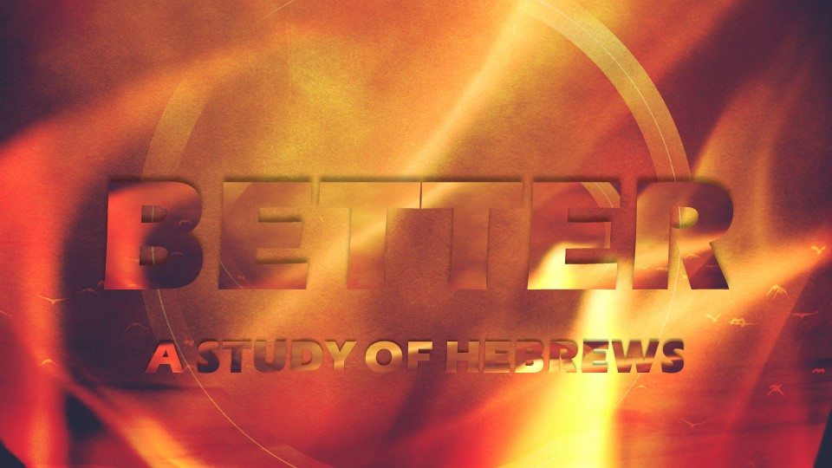

Slide 2

How do you describe
what cannot
be described?

Slide 3
Hebrews 1:1-14
Who is the Son?
  His Sonship
  His Being
  His Work
  His Name
  His Superiority

Slide 4
1. His Sonship (2)
Appointed heir of all things (cf. Ps. 2)
  Tied to Creation & Incarnation
  Includes the world to come (2:5-9)
  Ultimately fulfilled in Messianic Kingdom (Dan. 7:13-14; cf. 1 Cor. 15:22-28)

Slide 5
Nota Bene
Son does not mean procreation
  The 2nd Member of the Trinity is and has always been (John 1:1-2)
Heir/Inherit does NOT mean the Father will pass away!!! - God is immortal (1 Tim. 6:15-16)

Slide 6
1. His Sonship (2)
God made the world through Him (John 1:1-3, 10; Col. 1:15-17)
  World = ages -> everything that is contained in all time
  The Son reveals the Father, in creation & the Incarnation

Slide 7
2. His Being (3)
The radiance of God’s glory
  Effulgence – complete shining forth
    The shining of, not the light from
    Not Partialism! (distinct & same)
  Glory -> the total expression of His attributes (cf. goodness - Ex. 33:19)

Slide 8
2. His Being (3)
The exact representation of God’s nature or essence
  A manifestation of what the Godhead is (i.e. – divinity)
  “He who has seen Me has seen the Father” (John 14:9)

Slide 9
Nicene Creed
We believe in one Lord Jesus Christ, the only-begotten Son of God, begotten of the Father before all worlds; God of God, Light of Light, very God of very God; begotten, not made, being of one substance with the Father, by whom all things were made.

Slide 10
2. His Being (3)
Upholds all things by the word of His power
  He who spoke creation into existence bears it along to a pre-determined end (cf. Num. 11:14)

Slide 11
3. His Work (3-4)
Made purification of sins
  Atonement/covering -> purification (cf. Lev. 16)
  Thru substitutionary atonement, Jesus in Himself accomplished complete cleansing (see 9:1-10:18)

Slide 12
3. His Work (3-4)
Sat down at the right hand of the Majesty on high
  He completed His work! (10:11-18)
  The joy set before Him (12:2)
  Reward for His obedience (2:9; cf. 11:26; Phil. 2:5-11)

Slide 13
4. His Name (4)
He has inherited a more excellent name than the angels
  Not Jesus but Son of God (See Rom. 1:1-4)
  Aren’t angels called sons of God? (Job 1:6; 2:1; cf. Ps. 29:1; 89:6)

Slide 14
Homer A. Kent, Jr.
“Even though angels are called ‘sons of God’ in the wider sense of direct creations of God, it was always as a group. No individual angel is ever addressed as ‘son of God’ in all of Scripture, and certainly not in the unique sense indicated by Psalm 2:7.”

Slide 15
5. His Superiority
Must be understood in His redemptive role as Messiah
Proven with Scripture – God spoke in the prophets (see 1:1; cf. Acts 2:14-36; 3:11-26; 4:16-43)

Slide 16
5. His Superiority
Begotten (5) -> acknowledged (thru resurrection - see Acts 13:33)
  Coronation, exaltation (2:9; cf. Phil. 2:5-11)
    Father/Son from 2 Sam. 7:14

Slide 17
5. His Superiority
Firstborn (6) – place of prominence in relation to man (cf. Gen. 48:13-20)
  From the dead (Col. 1:18; Rev. 1:5)
  We are conformed to His image (Rom. 8:29; cf. Col. 1:15)
Angels commanded to worship Him

Slide 18
5. His Superiority
Throne / scepter (8) – the Son is King
  “Sit at My right hand”
  Angels are only servants (7, 14)
Creator (10-12)
  Pre-existent, powerful, imperishable, immutable, eternal

Slide 19
5. His Superiority
Enemies / footstool (13) – God wins
  No matter what happens, God will prevail over the rebellion
  Because of what Jesus did on the cross, the enemies are defeated
  All will be made right in the end

Slide 20
So What?
Jesus is superior to democracy
Jesus is superior to democratically- elected republic
Mankind is in rebellion against God
  Rebels hate those who love God
God will win (Ps. 2)

