Slide 1
Then beginning with Moses and with all the prophets, He explained to them the things concerning Himself in all the Scriptures. (Luke 24:27)

Slide 2
CHRIST IN THE BOOK OF AMOS
Instance 1 of 2
Amos 5:18-20 refers to the ‘Day of the Lord’
II Thessalonians 2:1-2 associates the ‘coming of our Lord Jesus Christ’ with the phrase ‘Day of the Lord’.

Slide 3
CHRIST IN THE BOOK OF AMOS
Instance 2 of 2
Amos 8:9 - “In that day” the “sun will go down at noon and darken the earth.”
Matthew 27:45-46 – “From noon until three in the afternoon darkness came over all the land.”

Slide 4
BENEFITS OF PROPHECY
So we can know ahead of time what’s going to happen
So we can know after the fact that what happened was part of God’s plan

Slide 5
GOD’S PLAN
THAT HE TELLS US AHEAD OF TIME MEANS
IT’S HIS PLAN
IT’S NOT MISSION ABOLISHED!
IT’S MISSION ACCOMPLISHED!!!

Slide 6
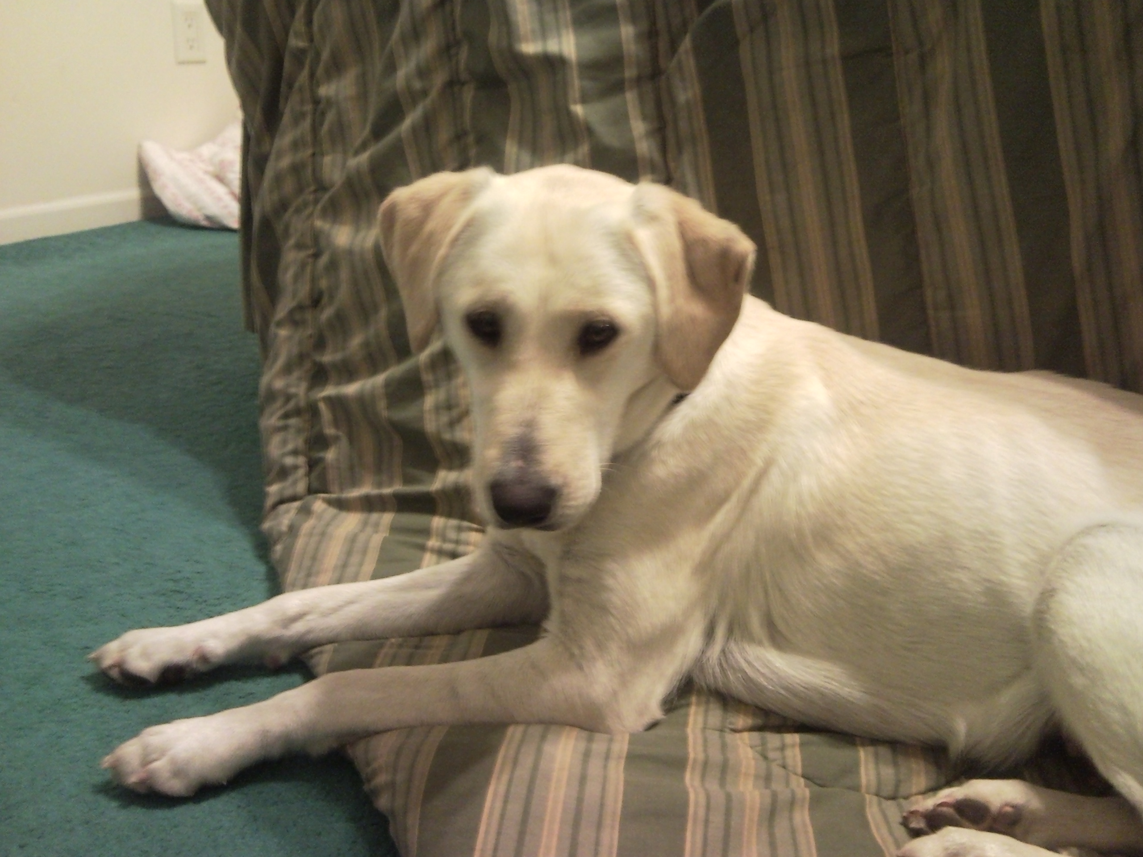

Slide 7
…and he PROMISED not to use this picture in his alleged ‘sermon’!

Slide 8
NUMBERS 9:15-22

Slide 9
GOD’S PLAN

Slide 10
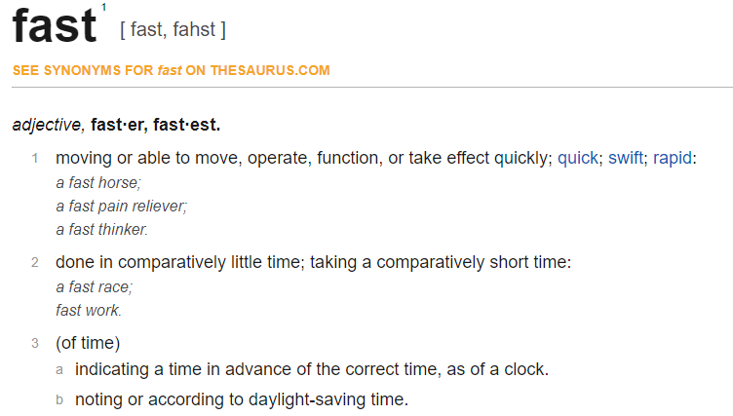

Slide 11
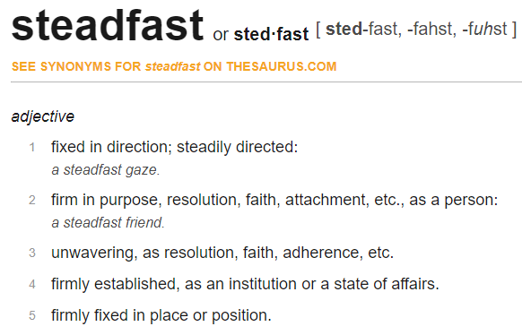

Slide 12
II CORINTHIANS 4:16-18

Slide 20
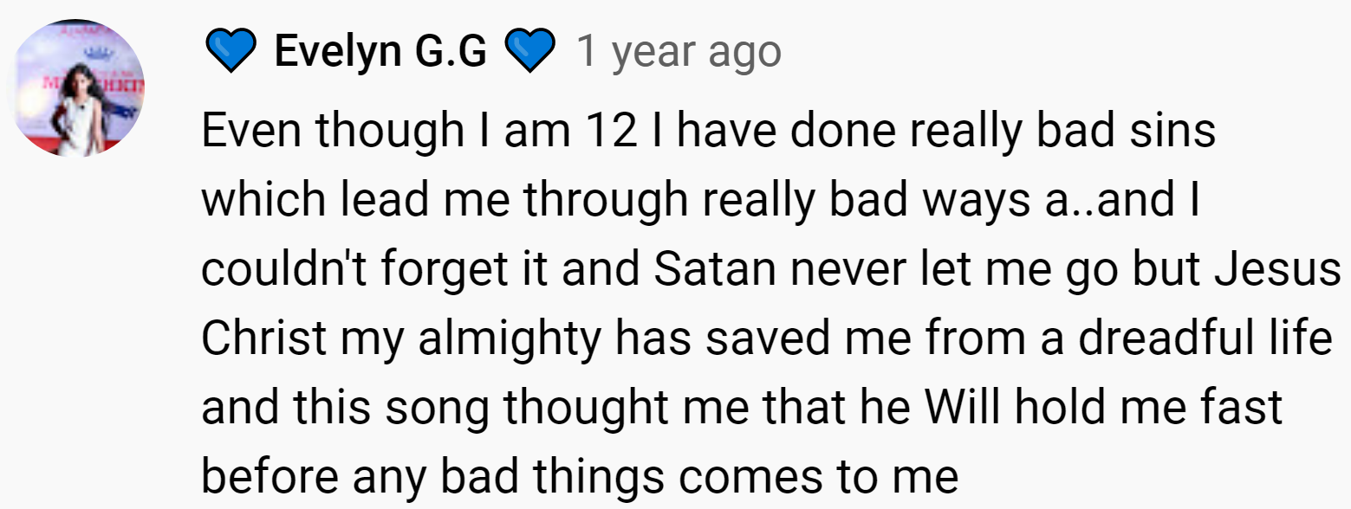

Slide 21
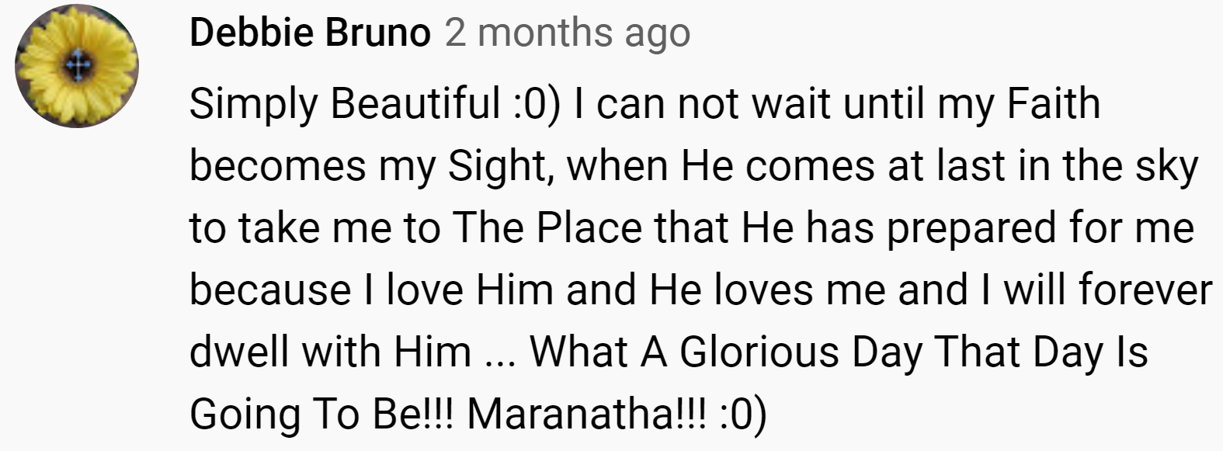

Slide 29
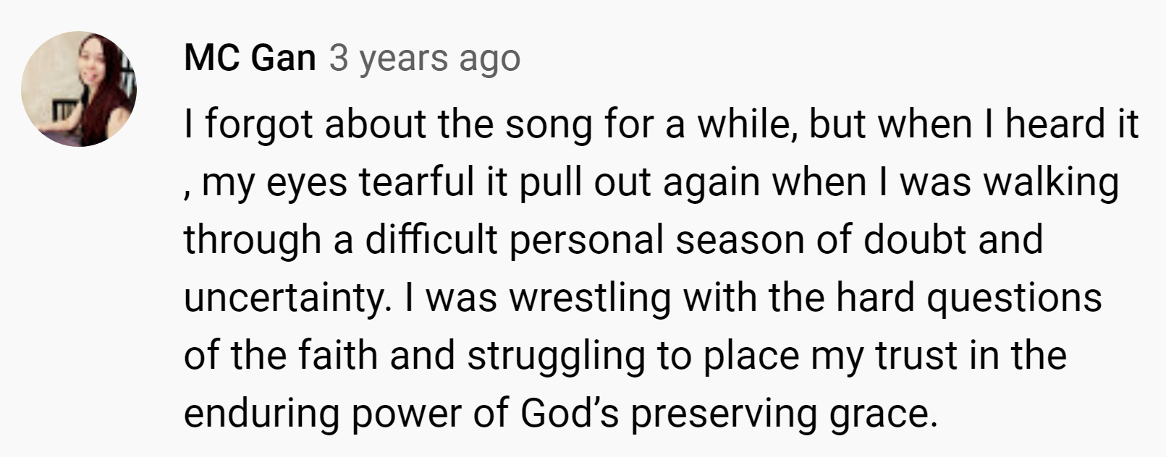

Slide 31
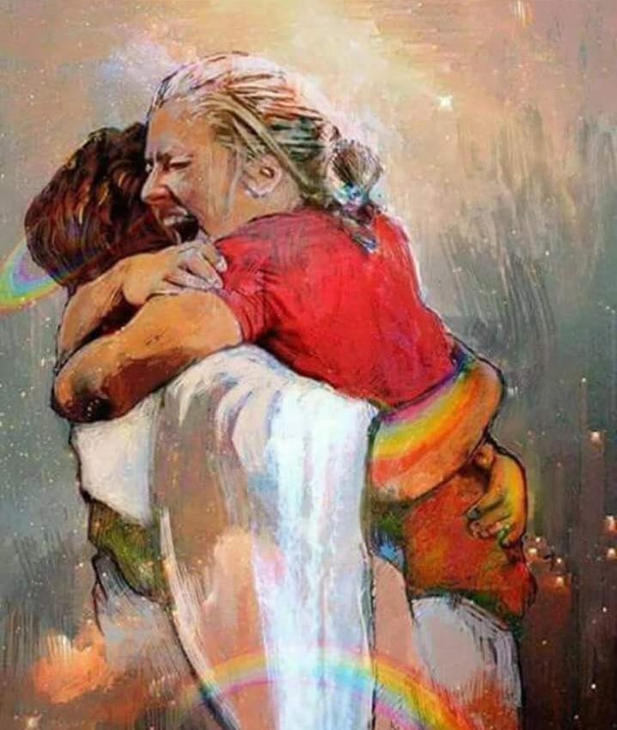
FIRST DAY IN HEAVEN

