Slide 1
Then beginning with Moses and with all the prophets, He explained to them the things concerning Himself in all the Scriptures. (Luke 24:27)

Slide 2
What Makes a Marriage?
A wedding ceremony?
Dwelling is the same house?
Doing things together?
Tax-filing status?

Slide 3
A Love Story
Hosea

Slide 4
A Brief Timeline
722 BC DISPERSED
AMOS
DAVID
SOLOMON
ISRAEL
(10 TRIBES)
HOSEA
JUDAH
(2 TRIBES)

Slide 5
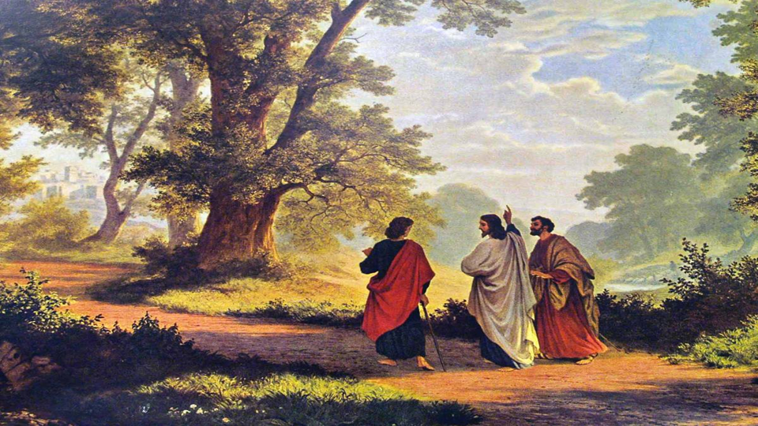
Setting of Hosea
Samaria, in Israel (10 northern tribes)
“during the days of Jeroboam [II] the son of Joash, king of Israel” (1:1)
  He reigned 41 years (2 Kings 14:23)
  “He did evil in the sight of the Lord” (2 Kings 14:24)

Slide 6
Setting of Hosea
See 2 Kings 17:7-22
  “they did evil things provoking the Lord” (11)
  God warned them through Amos and Hosea in Israel, and Isaiah and Micah in Judah (13)

Slide 7
The Theme of Hosea
Hosea = salvation or deliverance
Salvation for an unfaithful nation
  Symbolized by Hosea’s marriage to Gomer (1:2-3)
  She was unfaithful, like Israel, but like God, Hosea took her back (3:1)

Slide 8
The Living Illustration
God told Hosea to marry a woman who would become a harlot (1:2-3)
  Possibly cultic worship (4:14)
  Most likely very public
  Why would God ask Hosea to do this???

Slide 9
The Living Illustration
God had Hosea denounce Israel’s harlotry and pronounce His rightful judgement on it (2:1-13)
Yet, God also promised restoration (2:14-23)

Slide 10
The Living Illustration
Go, get your wife back (3:1)
  Love her as I love Israel, even though they don’t love Me
Hosea bought her (3:2) and called her to faithfulness (3:3)

Slide 11
The Living Illustration
Because of their sin, Israel would be exiled “for many days” (3:4)
  No leadership, no worship, no direction
  God was cutting them off completely, but not permanently

Slide 12
The Living Illustration
“Afterward the sons of Israel will return and seek the Lord their God and David their king” (3:5; Jer. 30:9)
  The 10 tribes had rejected the house of David (1 Kings 12:16)

Slide 13
The Promised One
Seed of Eve (Gen. 3:15)
Thru Seth (Gen. 5:3-32)
Thru Shem (Gen. 9:26-27)
Thru Abraham (Gen. 12:2-3)
Thru Isaac (Gen. 17:19, 21)
Thru Jacob (Gen. 28:14)

Slide 14
The Promised One
Thru Judah (Gen. 49:8-12)
Thru David (2 Sam. 7:8-17)
  “I will make them one nation … My servant David will be king over them, and they will all have one shepherd” (Ezek. 37:22-24)

Slide 15
The Living Illustration
This will take place after many days, in the last days (3:4-5)
  The culmination of God’s plan for Israel: judgment, restoration, renewal, Christ’s kingdom (cf. Isa. 2:2; Jer. 23:20; 49:39; Acts 2:17)

Slide 16
Coincidence?
Nation of Israel
Called out of Egypt
Thru Red Sea
Wilderness (40 yrs of testing)
Jesus (Matt. 2-4)
Out of Egypt I called My Son
Baptism
Wilderness (40 days of testing)

Slide 17
Out of Egypt (11:1-7)
Identification / Representation
  Jesus did what the Nation didn’t
    “So My people are bent on turning from Me.” (Hosea 11:7a)
    “I always do the things that are pleasing to Him.” (John 8:29b)

Slide 18
Out of Egypt (11:1-7)
Therefore, to be right with God, people from the Nation would need to identify with Jesus the Messiah, not Abraham (see Matt. 3:7-10; Rom. 9:6-9; Gal. 3:6-9)
  Even Abraham had to believe!

Slide 19
So What?
What are you trusting in?
  See Heb. 3:12-4:13
  Mark 4:3-25 – The Four Soils
Do you identify with Jesus?

Slide 20
So What?
Are you being faithful?
  Any false gods?
  “You adulteresses”? (James 4:1-10)
  Falling away? (1 Tim. 4:1-15)
  The apostasy? (2 Thess. 2:3)

Slide 21
Communion
Anything to make right with God?
  Confession -> forgiveness and cleansing (1 John 1:9)
  Only thru Jesus’ atonement!

