Slide 1
Then beginning with Moses and with all the prophets, He explained to them the things concerning Himself in all the Scriptures. (Luke 24:27)

Slide 2
Not Thy Will, But MINE
Jonah

Slide 3
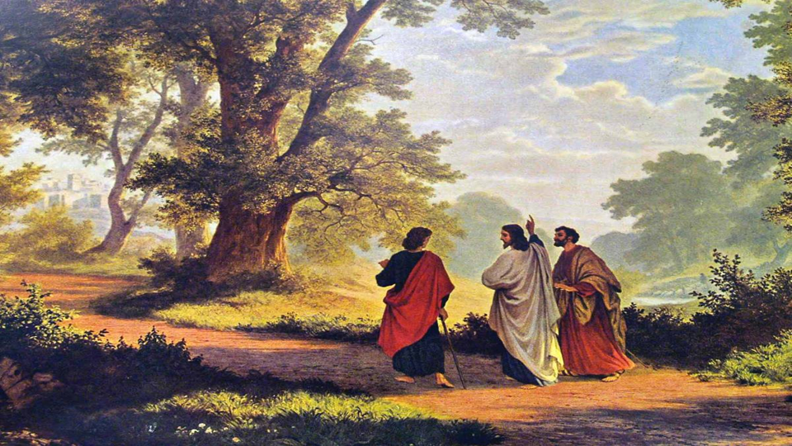
Who was Jonah?
Jonah = dove
“… according to the word of the Lord, the God of Israel, which He spoke through His servant Jonah the son of Amittai, the prophet, who was of Gath-hepher.” 2 Kings 14:25

Slide 4
A Brief Timeline
722 BC DISPERSED
DAVID
SOLOMON
ISRAEL
(10 TRIBES)
HOSEA
JONAH
OBADIAH?
JUDAH
(2 TRIBES)
AMOS

Slide 5
Structure of Jonah
Two parts: Chaps. 1-2 & Chaps. 3-4
Contains: chiasm, parallelism, irony, contrast, repetition, alliteration
Allusions to other OT stories
Cliffhanger ending (4:9-11)

Slide 6
Setting of Jonah
Before or during the reign of Jeroboam II (2 Kings 14:25)
  Israel was wicked & idolatrous, yet prosperous (restored borders)
  Assyria had dominated but was suffering temporary decline

Slide 7
Setting of Jonah
Contemporary of Amos and Hosea
  Both warned of God’s judgment
  “But Assyria—he will be their king Because they refused to return to Me.” (Hosea 11:5b,c)
God sent Jonah to Nineveh (Assyria)

Slide 8
Theme of Jonah
Grace
  Who gets it? How?
  What if I don’t think someone else deserves it?
God’s sovereignty

Slide 9
The Story of Jonah
God sent Jonah to warn Nineveh of their pending judgment
Jonah did not want to warn Nineveh, so he went the other direction
God convinced him to go to Nineveh
Nineveh repented & God relented

Slide 10
The Story of Jonah
Jonah was upset that God graciously spared the Assyrians (who would later destroy Israel)
  I knew you would do this! (4:1-3)
  “death is better to me than life”
God: Where is your compassion?

Slide 11
The Story of Jonah
Nineveh’s deliverance was a rebuke & illustration to unrepentant Israel
Israel was facing judgment but didn’t see any need to repent, because they were God’s people (descendants of Abraham)

Slide 12
Where is Jesus?
Matthew 12
  “Look, Your disciples do what is not lawful to do on a Sabbath.” (2)
  Jesus: “I desire compassion, and not a sacrifice” (7; cf. Hosea 6:6)
    The priests break the Sabbath (5)

Slide 13
Matthew 12
“Is it lawful to heal on the Sabbath?” (10)
Jesus: “…it is lawful to do good on the Sabbath.” (12)
  N.B. “the Gentiles” (cf. Isa. 42:1-4)

Slide 14
Matthew 12
Jesus healed a possessed man (22)
People: Is He the Son of David? (23)
Pharisees: “This man casts out demons only by Beelzebul the ruler of the demons.” (24)

Slide 15
Matthew 12
Jesus: “the mouth speaks out of that which fills the heart” (34)
  You brood of vipers, your fruit reveals you are evil
  Its not about the law, its about the heart!

Slide 16
Matthew 12
The Pharisees asked for a sign (i.e. – something indisputable) (38)
Jesus: “An evil and adulterous generation craves for a sign” (39)
  “yet no sign will be given to it but the sign of Jonah the prophet”

Slide 17
Matthew 12
“for just as Jonah was three days and three nights in the belly of the sea monster, so will the Son of Man be three days and three nights in the heart of the earth.” (12:40)

Slide 18
Where is Jesus?
Type – foreshadowing; pointing to ultimate fulfillment in Jesus
How did Jonah end up in the sea and the belly of the fish for 3 days/nights?
  The sailors had to sacrifice him (by faith) for their own deliverance

Slide 19
Where is Jesus?
How was evil Nineveh saved from God’s judgment?
  They repented (in faith) and “turned from their wicked way” (3:10)
Evil Israel refused to repent because they refused to see they were evil

Slide 20
Where is Jesus?
To whom did Jonah preach?
  To Gentiles – cf. Acts 10-15; 1 Cor. 14:20-22 (cf. Isa. 28:9-13); Romans 11 (“to make them jealous” 11)
Israel was to be a light, but instead despised the Gentiles

Slide 21
So What?
Who gets God’s grace?
  “God is opposed to the proud, but gives grace to the humble.” (James 4:6)
  Based on the heart, not birthplace, heritage, skin color, language, etc.

Slide 22
So What?
God can use anyone to accomplish His purposes
  Jonah was working against God and God still used him
  Don’t be afraid to say something

Slide 23
So What?
God use circumstances to address the needs of our hearts
  Why did God send Jonah?
  What is happening in your life?
  Are you open to God’s agenda?
  What is God trying to show you?

