Slide 1
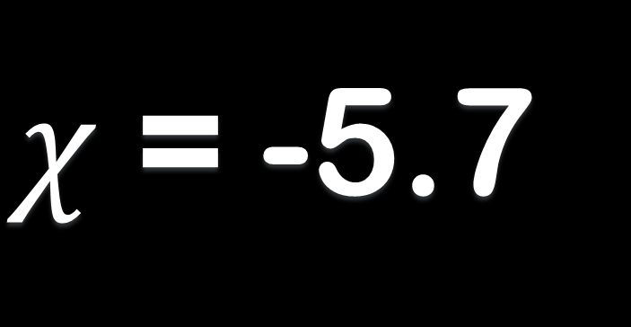

4$χ$ + 15 = 2/3$χ$ - 4
$χ$ = -5.7

Slide 2
Then beginning with Moses and with all the prophets, He explained to them the things concerning Himself in all the Scriptures. (Luke 24:27)

Slide 3
“Remember Me?”
Malachi

Slide 4
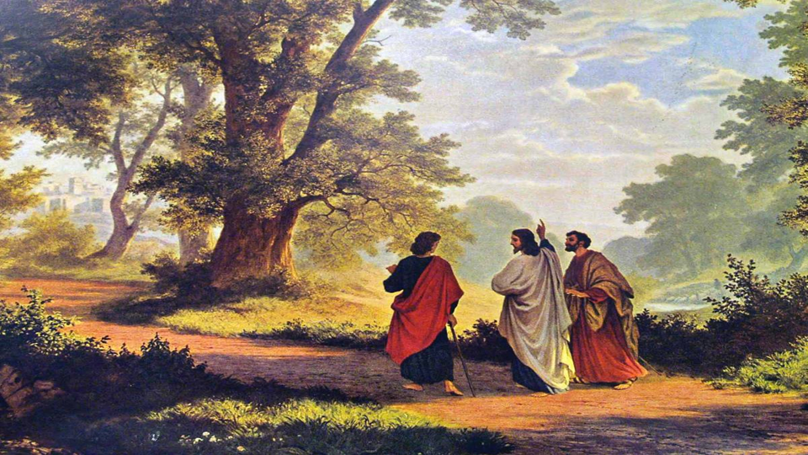
Who was Malachi?
Malachi = My Messenger (Angel)
  Delivered oracles for YHWH (1:1)
    Oracle = load, burden
    Responsibility (cf. Rom. 3:1-2)
Returned from exile in Babylon (with Ezra or Nehemiah?)

Slide 5
Structure of Malachi
A series of disputes:
  Assertion: “I have loved you” (1:2)
  Question (accusation): “How have you loved us?”
  Response (evidence): “Jacob I loved; Esau I hated”

Slide 6
Structure of Malachi
A series of disputes:
  No honor or respect (1:6-2:12)
  You broke the covenant (2:13-16)
  You perverted justice (2:17-3:6)
  You turned aside (3:7-12)
  Spoke words against God (3:13-15)

Slide 7
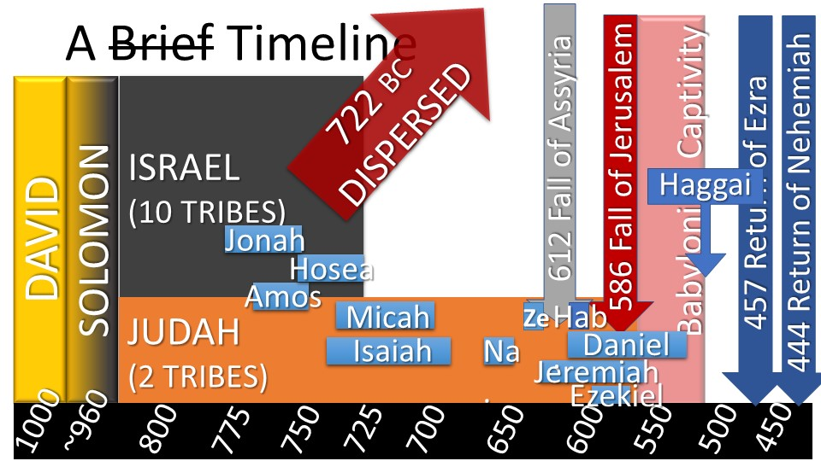
MALACHI
400

Slide 8
Setting of Malachi
After the exile
The 2nd temple was completed
The priests were careless/corrupt
The people had become complacent
Religious life was mechanical/empty

Slide 9
Theme of Malachi
Remember/return to the covenant!
  “‘From the days of your fathers you have turned aside from My statutes and have not kept them. Return to Me, and I will return to you,’ says the Lord of hosts.” (3:7)

Slide 10
Theme of Malachi
Remember/return to the covenant!
  Constant theme throughout their history (cf.– Deut. 28-30; prophets)
  They accused God of being unfaithful: “Where is the God of justice?” (2:17)

Slide 11
Where is Jesus?
See Ex. 23:20-33
  “Behold, I am going to send an angel before you…”
  “My name is in him”
  “You shall not worship their gods … nor do according to their deeds”

Slide 12
Where is Jesus?
See Ex. 32
  Israel: “Come, make us a god…” (1)
  God: “behold, they are an obstinate [KJV: stiffnecked] people” (9)
  “Behold, My angel shall go before you; nevertheless…” (34; 33:1-6)

Slide 13
Where is Jesus?
See Judges 2
  Angel: “I brought you up out of Egypt and led you…” (1-2)
  “But you have not obeyed Me”
  “Because this nation has transgressed My covenant…” (20)

Slide 14
Where is Jesus?
See Mal. 3:1-7
  “Behold, I am going to send My messenger [angel], and he will clear the way before Me.”
    Israel was like the wicked nations
    God would drive out the wicked

Slide 15
Where is Jesus?
See Mal. 3:1-7
  “And the Lord,” “the messenger of the covenant,” “behold, He is coming” (i.e. – Jesus)
  “But who can endure the day of His coming?” (see 2:17)

Slide 16
Where is Jesus?
See Mal. 4:4-6
  “Remember the law of Moses …”
  “Behold, I am going to send you Elijah the prophet…”
  cf. Transfiguration (Matt. 17:1-13)
    Two witnesses??? (Rev. 11:1-13)

Slide 17
Where is Jesus?
See Matt. 11:7-15
  “Behold, I send My messenger ahead of You, Who will prepare Your way before You.” (cf. Isa. 40:3-5)
  “John himself is Elijah who was to come” (a type; cf. Matt. 3:1-12)

Slide 18
Where is Jesus?
When Jesus returns:
  He will purify and unify Israel
  He will restore Israel’s relationship with God (New Covenant)
  He will restore Israel to the land
  He will fulfill the kingdom promises

Slide 19
So What?
Are we like Israel: complacent, careless, mechanical, tolerant of sin?
We are not under the Old Covenant!
But the New Covenant has the same goal: holiness (1 Pet. 1:13-16)
  Requires purification (1 Pet. 4:7-19)

