Slide 1
Then beginning with Moses and with all the prophets, He explained to them the things concerning Himself in all the Scriptures. (Luke 24:27)

Slide 2
Family Feud
Obadiah

Slide 3
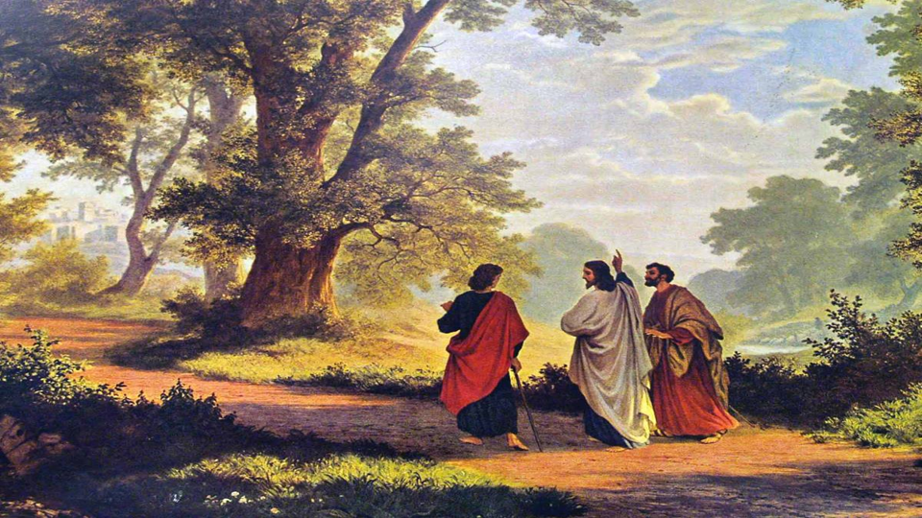
Who was Obadiah?
We don’t know for sure
  12 men named Obadiah in OT
  No details given anywhere
Obadiah = servant / worshiper of Yah

Slide 4
A Brief Timeline
722 BC DISPERSED
OBADIAH
ISRAEL
(10 TRIBES)
605 BC
Jerusalem Destroyed
597 BC
JUDAH
(2 TRIBES)
586 BC
JEREMIAH
(Jerusalem)
LAMENTATIONS

Slide 5
Theme of Obadiah
Judgment on the nation of Edom
  Edom = Esau and his descendants (cf. Gen. 25:30; 36:1, 8, 9)
    Esau symbolizes folly, sensuality, immorality, godlessness
      The birthright (Gen. 25:27-34)

Slide 6
The Backstory
“Two nations are in your womb; And two peoples will be separated from your body; And one people shall be stronger than the other; And the older shall serve the younger.” (Gen. 25:23; cf. Rom. 9:10-13)

Slide 7
The Backstory
Wrestling in the womb (Gen. 25:22)
Jacob grasped Esau’s heel (25:26)
Jacob ‘bought’ the birthright (25:33)
Jacob stole the blessing (27:1-29)
Esau blessed? (27:39-40)
Esau plotted revenge (27:41)

Slide 8
The Backstory
Edom rejected Israel (Num. 20:14-21)
Israel subjugated Edom (2 Sam. 8:14)
Edom revolted (2 Chron. 21:8-17)
Edom helped Aram & Israel take Jerusalem (2 Chron. 28)
Edom helped Babylon (Ps. 137:7-8)

Slide 9
Theme of Obadiah
God’s verdict: Guilty!
  Arrogance (3)
  Violence (10)
  Gloating (12)
  Looting (13)
  Mistreatment of fugitives (14)

Slide 10
Theme of Obadiah
The Sentence:
  “As you have done, it will be done to you.” (15b)
  “you will be cut off forever” (10c)
  “there will be no survivor of the house of Esau” (18e)

Slide 11
Structure of Obadiah
A: Edom’s Humiliation (1-4)
B: Judgment on Edom (5-9)
B’: Judgment on Israel (10-14)
A’: Israel’s Exaltation (15-21)

Slide 12
Where is Jesus?
“the day of the Lord draws near” (15a)
  Past day: e.g. - Assyria (Amos 5:18)
  Mostly future: e.g. - Isa. 2:10-22
    Jesus is central (2 Thess. 1:9-10; cf. Revelation)

Slide 13
Renald Showers
“The Day of the Lord refers to God’s special interventions into the course of world events to judge His enemies, accomplish His purposes for history, and thereby demonstrate who He is—the sovereign God of the universe….”

Slide 14
The Future Day
2nd COMING
RAPTURE
The Day of the Lord
MILLENNIAL KINGDOM
TRIBULATION
7 yrs.

Slide 15
Where is Jesus?
“the day of the Lord draws near on all the nations” (15a)
  Edom typifies those who stand against God’s purposes (Isa. 63:1-6; Amos 9:12; Mal. 1:2-4)
  7 seals, trumpets, bowls (Rev. 6-20)

Slide 16
Where is Jesus?
“And the kingdom will be the Lord’s” (21c; cf. Luke 1:30-33; Rev. 11:15-19; 22:1-5)
  Jesus on David’s throne (Isa. 60:1-3; Ezek. 37:24; Amos 9:11-12)

Slide 17
So What?
“For the day of the Lord draws near on all the nations.” (15a)
“Righteousness exalts a nation, But sin is a disgrace to any people.” (Prov. 14:34)
  What are the wages of sin?

Slide 18
So What?
“As you have done, it will be done to you. Your dealings will return on your own head.” (15b,c)
“Do not be deceived, God is not mocked; for whatever a man sows, this he will also reap.” (Gal. 6:7)

Slide 19
So What?
What has our country been sowing?
  Overall, are we moving toward righteousness?
  Love your neighbor as yourself???
  What does that mean for us as a nation?

Slide 20
So What?
Don’t be like Esau! (Heb. 12:14-17)
  Pursue peace and sanctification
  Choose heavenly over earthly
  Choose eternal over temporal
God uses the earthly/temporal to encourage holiness (12:1-13)

