Slide 1
Project 2021 Update
August 30, 2020

Slide 2
Clarification &
Reminder
There will be no vote today. We don’t vote
in Family Meetings.
Today is intended to be an update and discussion regarding the path forward.

Slide 3
Timeline of Events
Congregation
Vote Approves $10k for planning development
2015
Bldg Committee
Selects
contractors
2014

Slide 4
Quick Update (From January 2020)
2014: WBC Family Approved replacement of Modular Buildings
2015: Building Committee Interviews Contractors
2016: Architect and General Contractor Selected

Slide 5
Timeline of Events
Congregation approves $21k for design plans
Issues Resolved
Congregation
Approves $10k
for planning development
2015
Bldg Committee
Selects
contractors
2014
2017

Slide 6
Quick Update (From January 2020)
2017: Developing Building and financial plans (bldg. fund @ 54k April 2017)
2017: WBC family Commits Money for Design Drawings and site engineering
2018: Planning and Design (bldg. fund @ $69k at Year End)

Slide 7
Timeline of Events
Congregation approves $21k for Permanent
design plans
Issues Resolved
Congregation
Approves $10k
for planning development
2015
2019
Plans updated
For Phase 1
& Today
Bldg Committee
Selects
contractors
My commitment
campaign
2014
2017
2020

Slide 8
Quick Update (From January 2020)
2019: Leadership and Family approve transfer of $75k from gen. fund to bldg. fund
2019: My commitment campaign kicks off Sept. 2019
2019: Planning and Design (bldg. fund @ $187k at Year End)

Slide 9
My Commitment Campaign Update
$145k Committed by 45% of our Members/Reg. Attendees
TO Date: $59,064 Pledges received*
Remaining Pledges: $84,460
Additional Gifts: $42,075

Slide 10
Building Fund
$244,637.04
$186,784.55
$68,656.05
$59,237.45
2017
2018
2019
2020

Slide 11
My Commitment Campaign Update
Current Building Fund Balance
$244,637.04

Slide 12
My Commitment Campaign Update
When Pledges come in…
$329,097.04

Slide 13
Project 2021 Updated Plans
August 30, 2020

Slide 15
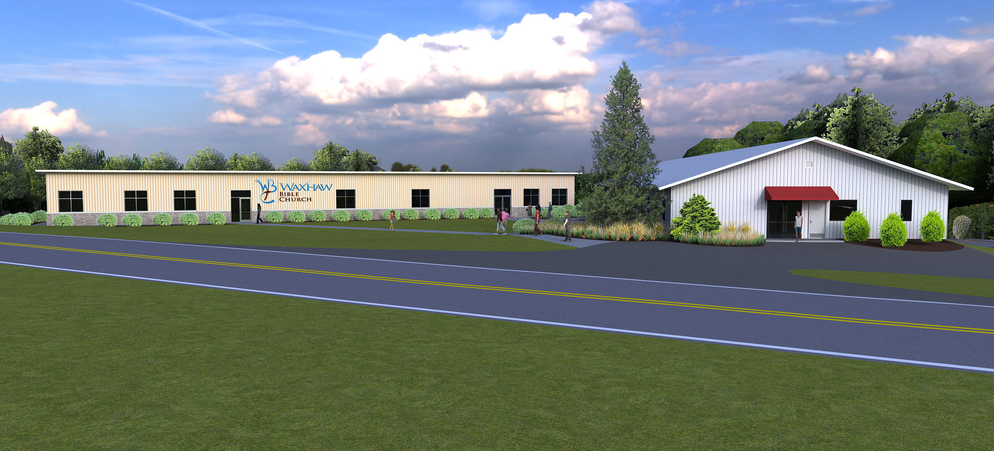

Slide 16
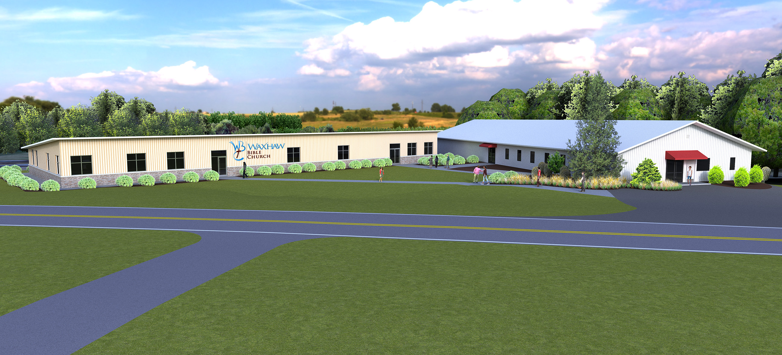

Slide 17
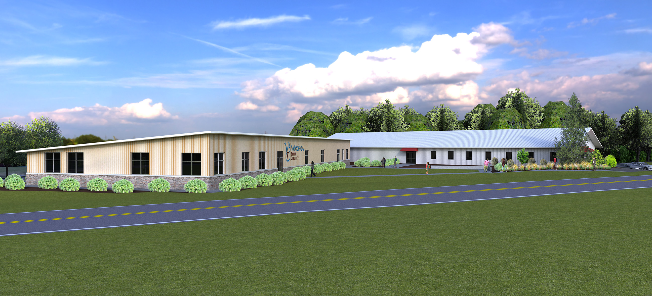

Slide 18
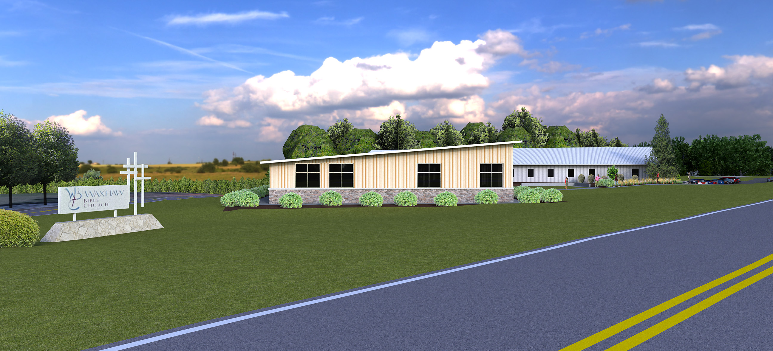

Slide 19
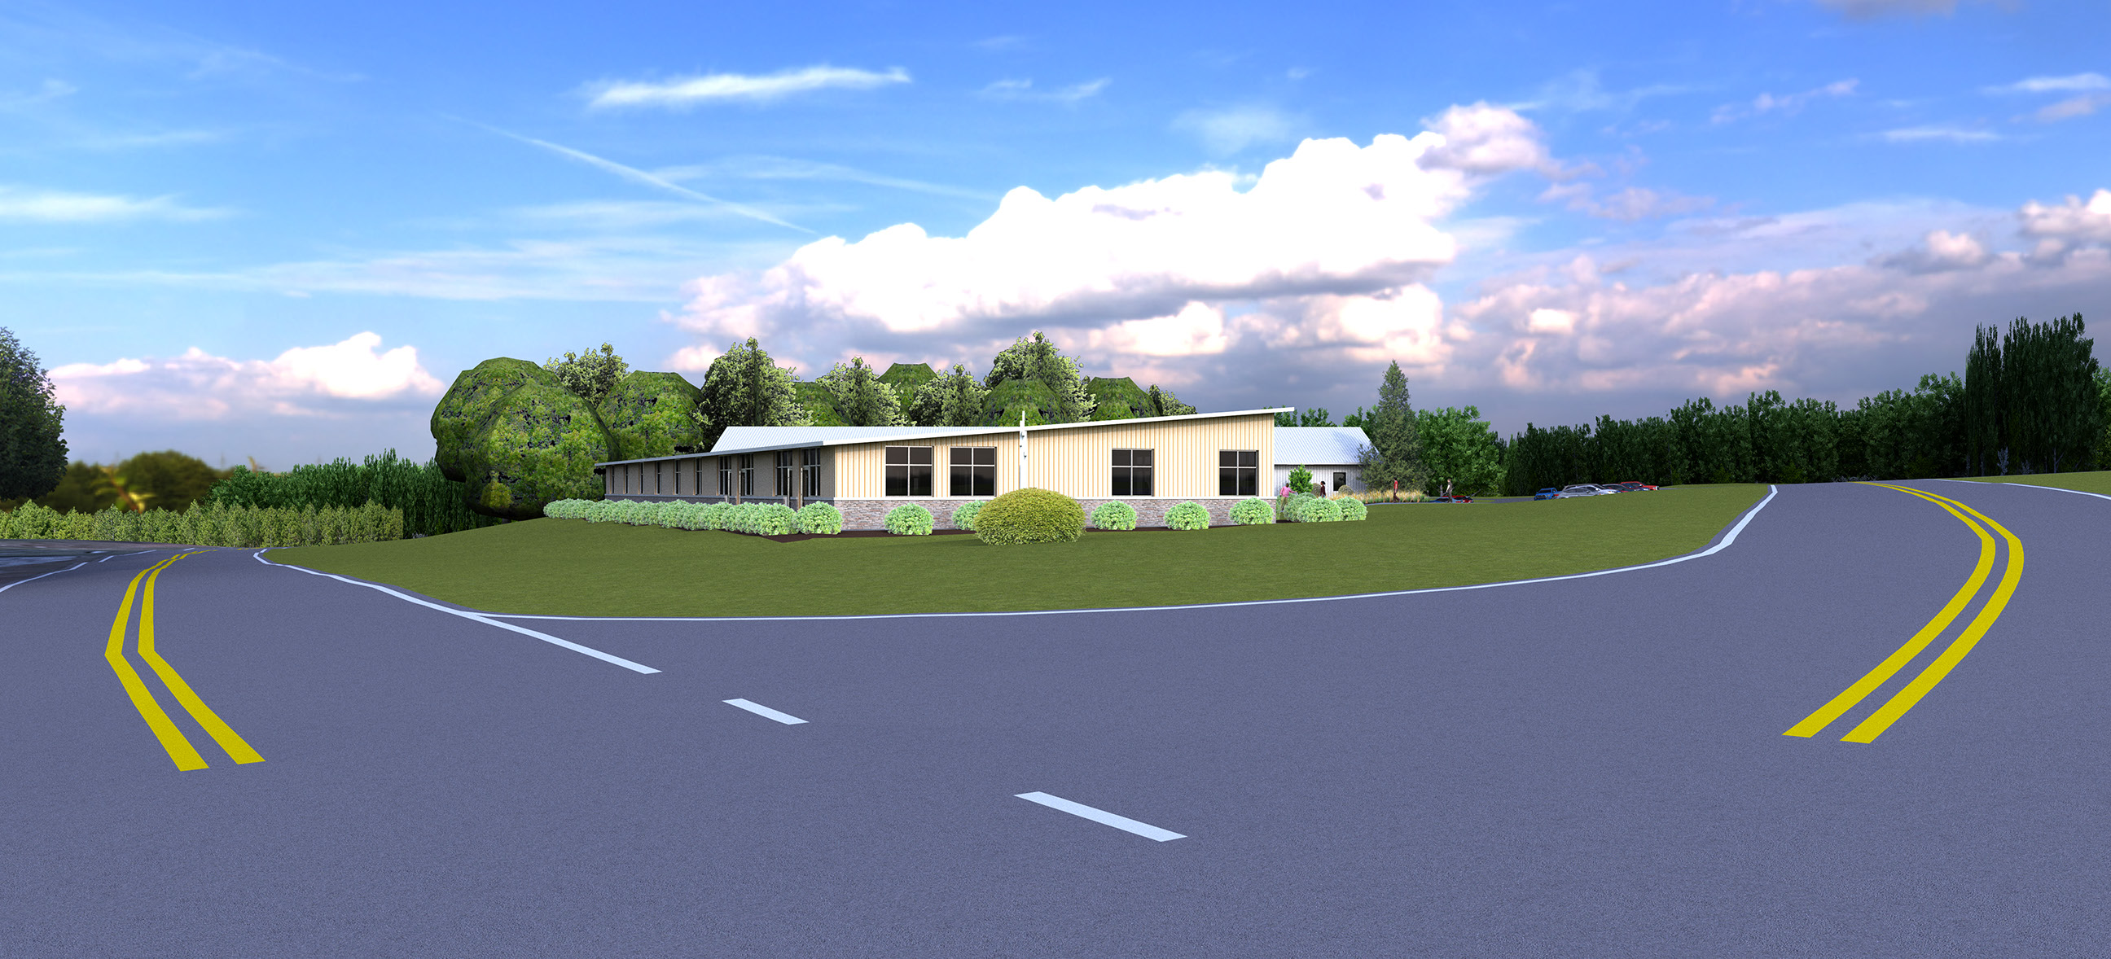

Slide 26
Projected Building Fund
May 2021
$329,097.04
Estimated Difference
$1,133,108
Estimated Phase 1 Cost
$1,462,205

Slide 27
Q
&
A

Slide 28
Big Questions
How do we bridge the gap between what we have and what is needed?
How long can the existing modular be utilized for ministries?

