Slide 1
As We Close the door on
Project 2021
We Prayerfully
consider our
next steps…

Slide 2
Recap of Project 2021 Congregation Votes
November 15, 2020
Building Item 1: Revised wording
We, the Waxhaw Bible Church family, believe the best way we can steward the resources God has entrusted to us is to replace the 3 existing modular buildings with a permanent foundation-based replacement.
72 yes – 1 no
Approved

Slide 3
Building Item 2: Revised wording
We will set an initial capital goal of $500k (proposed) as a threshold. Once our building fund has reached a balance of $500k, the leadership may begin the formal process of pursuing a loan, if necessary, leaving approximately $900k (which is about 3x our annual general budget), which is based on the current proposed building plan. (The congregation will separately need to approve the loan terms, once negotiated.)
67 yes – 6 no
Approved
(the threshold for approval is 2/3 of members present voting yes, so for this meeting 49 needed for approval. We had 91.7% yes)

Slide 4
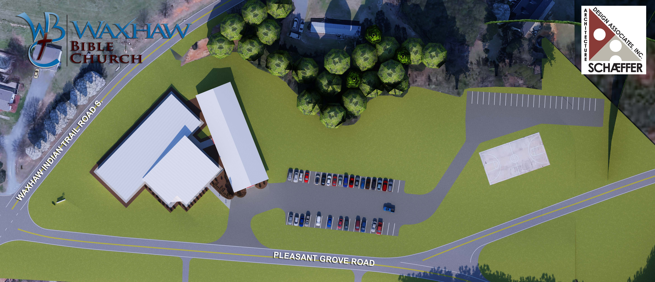
Phase 1
Existing
Phase 2

Slide 5
Phase 1 Includes:
14 Classrooms
5 Offices & Reception Area
Restrooms and Storage Areas

Slide 6
Current Details:
Building Fund now at $506k (up from $50k in 2018)
Since 2019 we would expect to see an increase in Construction Costs from $119 per square foot to somewhere between $145 and $165 per square foot.
  In 2019 the 9,600sf building (Ph.1) would have cost $1,142,400 (not including site work($319k))
    At $145/sf = $1,392,000
    At $155/sf = $1,488,000
    At $165/sf = $1,584,000
  Including Site Work we would expect to pay between $1.7 to $1.9mil for Phase 1 (9,600sf)

Slide 7
Current Details:
Modular Status:
  Replaced Siding on 200
  In the process of replacing flooring in 300
  Recently re-roofed 300 & 400
  Half of HVAC system functional in 400

Slide 8
Path Forward:
We have a significant gap between cash on hand and what is needed to build.
  Right now between $1.2 and $1.5mil
Financing (Commercial Loans at a glance)
  Appx. $8,000-$8,500 per month (or ~$1,900 per week) for a loan

Slide 9
Path Forward:
We need to discuss and decide on our position on corporate debt as a church.
  If “yes” to debt, how much are we willing/able to carry? Previous conversation was around 3x of Operating Budget, or about $900k.
  If “no” to debt, how do we resolve our building issues and what do we do with the cash on hand?

Slide 10
Path Forward:
We would ask that we all search the Scriptures, pray, ask questions, in preparation for a Business Meeting in 6 weeks.
Based on the Nov. ‘20 vote, the leadership will enlist a task group to investigate finance details and possibilities and present to the congregation on April 3rd at a Church Business meeting.

